Slide 1
Entering Reason Not Tested Codes
Summative Training Module
Copyright © Cambium Assessment, Inc. All rights reserved.
Notes:
Welcome to the online training module for Entering Reason Not Tested codes in TIDE. In this training module, we will walk through the process for entering Reason Not Tested codes to explain student non-participation in the assessment. Your state may also refer to Reason Not Tested codes as non-participation or special codes.

Slide 2
TIDE Training Modules
Activating Your Account and Navigating Through TIDE
Adding and Editing Users
Adding and Editing Students and Student Test Settings
Adding Students with Temp ID*
Managing Rosters
Printing Test Tickets and PreID Labels
Appeals Process
Entering Reason Not Tested Codes
*Only applicable to states that allow Temp IDs in TIDE
Notes:
The “Entering Reason Not Tested Codes” module is last in a series of online training modules on the TIDE system and its features. Visit the other training modules to learn about other features in TIDE and check out the TIDE User Guide on your state’s portal for additional information about features in your state’s version of TIDE.
Please note that your state’s version of TIDE may be different from the images shown in this presentation.

Slide 3
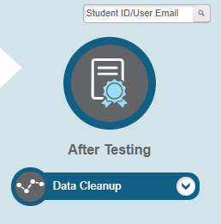
Data Cleanup
Notes:
In the After Testing section of the TIDE dashboard, the Data Cleanup task menu lets users enter Reason Not Tested Codes to explain student non-participation and resolve test discrepancies.

Slide 4
Reason-Not-Tested Codes
A non-participation event occurs when a student does not take a test as scheduled.
You assign a code to explain the non-participation.
Reason-Not-Tested codes persist until they are changed.
Reason-Not-Tested codes may also be referred to as special codes or non-participation codes depending on the terminology used in your state policy.
Notes:
There are circumstances in which a student did not participate in an expected test or participated in a test but in a non-standard way. Examples could include a student inadvertently taking an incorrect test, a parent opt-out, or the student not receiving appropriate instruction prior to the test. In such instances, you need to assign a non-participation or reason-not-tested code to the student’s test so that the Reporting System can accurately explain the non-participation.
For a list of Reason Not Tested codes and their descriptions, please consult your state’s TIDE User Guide.

Slide 5
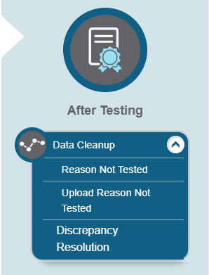
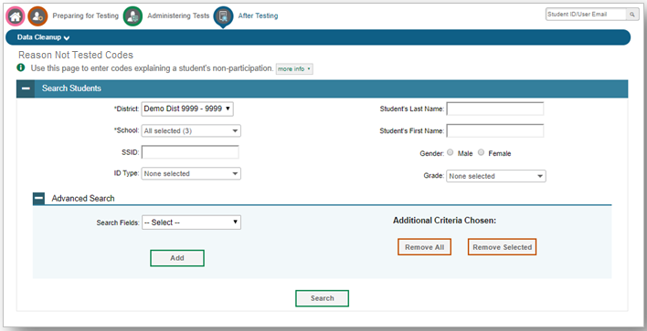
View Reason Not Tested Codes
Notes:
To view or edit a student’s Reason Not Tested Codes from the Reason Not Tested Codes page, select a district and school from the drop-down lists, if available. You may enter a student’s first or last name, SSID, gender, or assessed grade if desired. You can further refine your criteria by entering additional demographic information or test settings in the Advanced Search panel.
Click Search to retrieve a list of students matching your selected criteria. If your user role permits, you can edit a student’s Reason Not Tested Codes by clicking the green pencil icon next to each student’s name in the search results page.

Slide 6
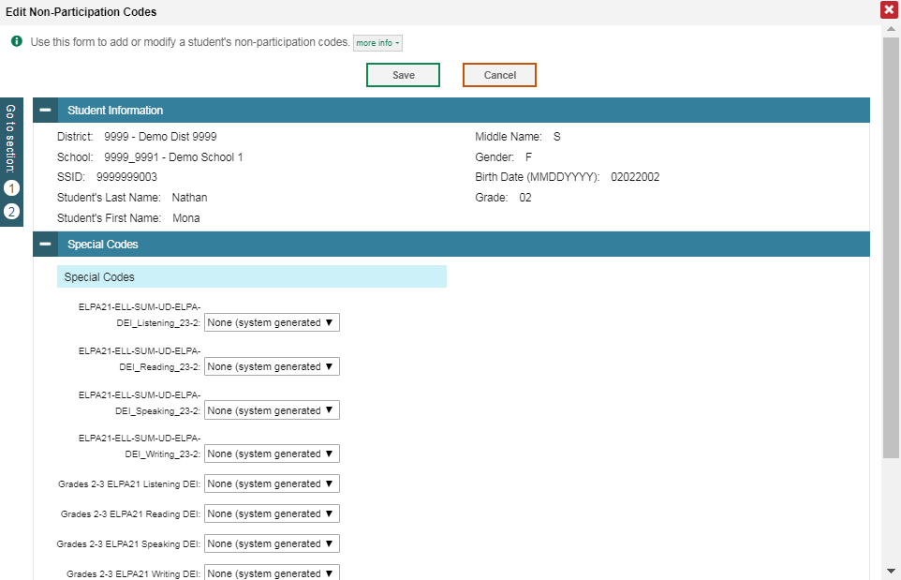
View Reason Not Tested Codes Results
Notes:
When you click the green pencil icon, another page will appear where you can edit and save the student’s Reason Not Tested Codes. The Student Information panel provides the student’s demographic information. The student’s available tests and special codes are listed in the Special Codes panel.
To edit the student’s Reason Not Tested Codes, from the drop-down lists in the Special Codes panel, select the special code for each available test, as required, and click Save.

Slide 7
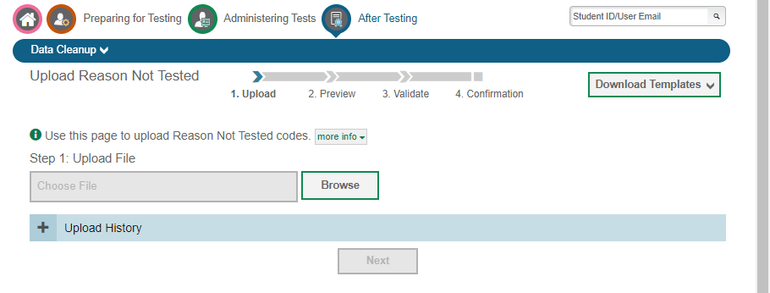
Upload Reason Not Tested Codes
Notes:
To enter Reason Not Tested Codes for multiple students, select Upload Reason Not Tested from the Data Cleanup task menu.
Download the provided template and choose from the Test dropdown and Code dropdown selectors. Upload the completed form.

Slide 8
Thank You!
For additional information, consult your portal’s Resources page, which contains:
Important announcements
TIDE User Guide
For further assistance, please consult your state’s Help Desk.
Notes:
Thank you for viewing this training module. For additional information, refer to your TIDE User Guide located on your portal. You may also wish to view additional resources available on your state's portal.
If you have general questions or need further information, please consult your state’s Help Desk for assistance.

