Slide 1
Printing Test Tickets and PreID Labels
TIDE Training Module #7
Copyright © 2023 Cambium Assessment, Inc. All rights reserved.
Notes:
Welcome to the online training module for Printing Test Tickets and PreID Labels in TIDE. In this training module, we will walk through the process for printing test tickets and PreID labels for your students during the test administration window.

Slide 2
TIDE Training Modules
Activating Your Account and Navigating Through TIDE
Adding and Editing Users
Adding and Editing Students and Student Test Settings
Adding Students with a Temporary ID (for Screener only)
Managing Rosters
Appeals Process
Printing Test Tickets and PreID Labels
Ordering Paper, Large Print, Braille Tests, and Tracking Shipments*
Entering Reason Not Tested Codes (for Summative administration only)
*Only applicable to states that elect to use the paper ordering module in TIDE
Notes:
The “Printing Test Tickets and PreID Labels” module is seventh in a series of online training modules on the TIDE system and its features. Visit the other training modules to learn about other features in TIDE and check out the TIDE User Guide on your state’s portal for additional information about features in your state’s version of TIDE.
Please note that your state’s version of TIDE may be different from the images shown in this presentation.

Slide 3
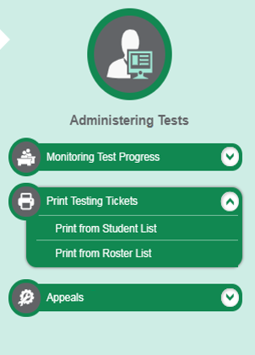
Printing Testing Tickets
Notes:
A test ticket is a hard-copy form that includes a student’s username for logging in to a test. TIDE generates the test tickets as PDF files that you download with your browser.
In the Administering Tests menu in TIDE, you can print test tickets from either the Print from Student List or the Print from Roster List.

Slide 4
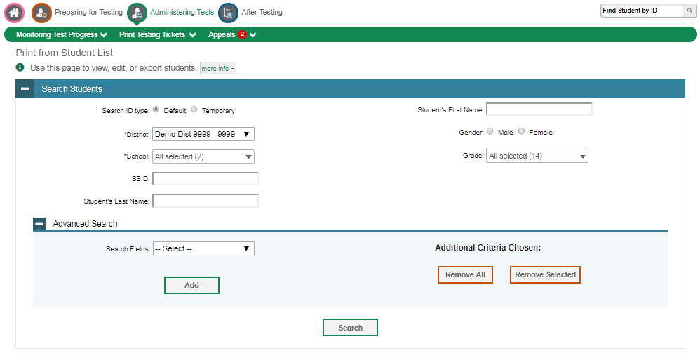
Printing Testing Tickets (Continued)
Notes:
Use the search feature to retrieve the students for whom you want to print test tickets and click Search. In the pop-up menu that appears, click View Results.
If you opt to print from a roster list, use the search options to retrieve the rosters for which you want to print test tickets, and click Search to move onto the next page.

Slide 5
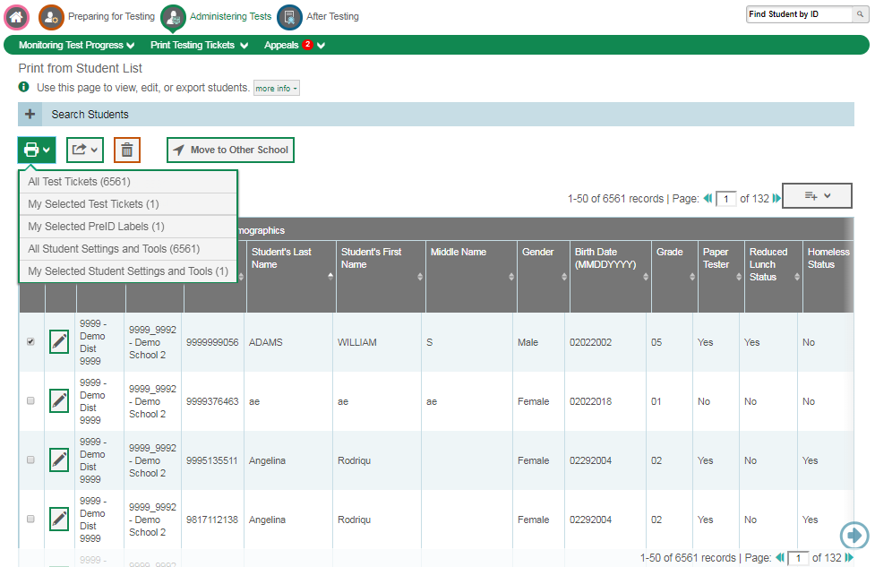
Printing Testing Tickets (Continued)
Notes:
Click the column headings to sort the retrieved students in the order you want the test tickets printed. Specify the students for whom test tickets need to be printed by marking the checkboxes next to each student in the table. You can mark the checkbox at the top of the table to select all students listed on the page. If you want to print all retrieved students, no additional action is necessary. The option to print all retrieved records is available by default. Click the print icon and then select the appropriate action:
All Test Tickets
My Selected Test Tickets
My Selected PreID Labels
All Student Settings and Tools
My Selected Student Settings and Tools.
If you are printing by roster, click the column headings in the retrieved roster list to organize the rosters in the order you want test tickets printed. Specify for which rosters you would like to print test tickets by marking the boxes next to each roster, or mark the checkbox at the top of the table to select all rosters. Click the print icon and then select Test Tickets in the drop-down menu. Verify print options in the new browser window that opens and click Print to download the generated PDF.

Slide 6
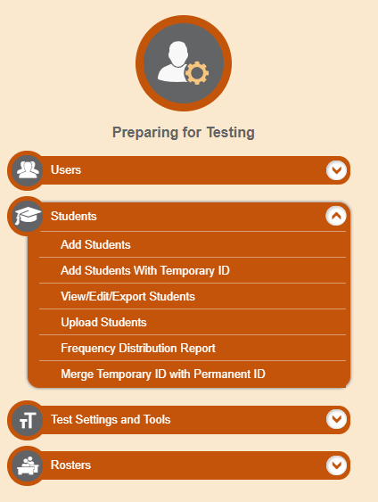
Printing PreID Labels
Notes:
PreID labels are a label that you affix to a student’s testing materials, such as a test booklet. To print PreID labels, you first need to retrieve the students for whom you want to print labels by selecting View/Edit/Export Students in the Preparing for Testing menu.

Slide 7
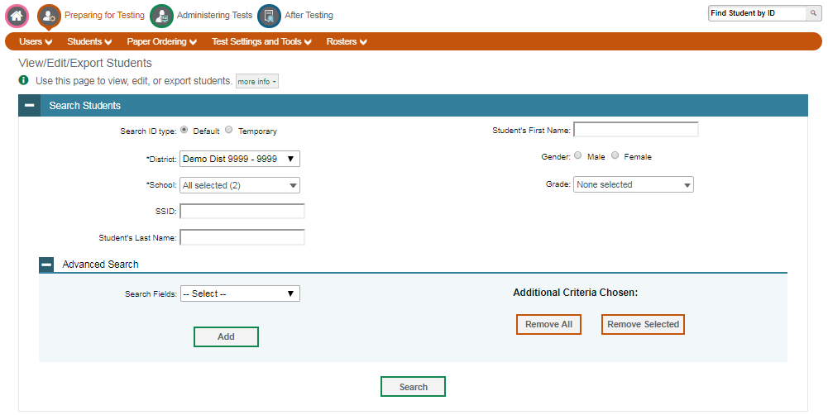
Printing PreID Labels (Continued)
Notes:
Use the search features to retrieve the students for whom you want to print labels and click Search. In the pop-up menu that appears, click View Results.

Slide 8
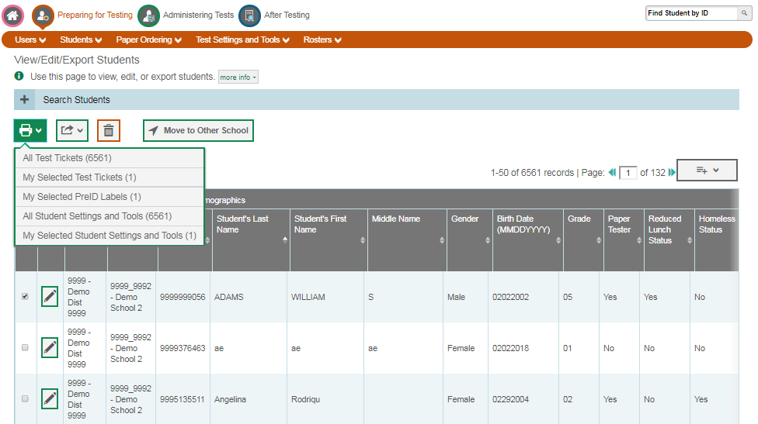
Printing PreID Labels (Continued)
Notes:
This page can also be accessed from the “Printing from Student List” page where you can print test tickets.
Click the column headings to sort the retrieved students in the order you want the labels printed.
Specify the students for whom labels need to be printed by marking the checkboxes next to each student in the table. You can mark the checkbox at the top of the table to select all students listed on the page. If you want to print all retrieved students, no additional action is necessary. The option to print all retrieved records is available by default.
Click the print icon and then select the appropriate action:
All Test Tickets
My Selected Test Tickets
My Selected PreID Labels
All Student Settings and Tools
My Selected Student Settings and Tools
Verify print options in the new browser window that opens and click Print to download the generated PDF. Print the PreID labels using the blank labels your district received with the initial shipment of student books. If you need additional blank labels, call your state’s Help Desk.

Slide 9
Thank You!
For additional information, consult your state portal, which contains:
Important announcements
TIDE User Guide
For further assistance, please consult your state’s Help Desk.
Notes:
Thank you for viewing this training module. For additional information, refer to your TIDE User Guide located on your portal. You may also wish to view additional resources available on your state’s portal.
If you have general questions or need further information, please consult your state’s Help Desk for assistance.

