Slide 1
Activating Your Account and Navigating Through TIDE
TIDE Training Module #1
Copyright © 2023 Cambium Assessment, Inc. All rights reserved.
Notes:
Welcome to the online training module for Activating your Account and Navigating Through TIDE. In this training module, we will walk through the process for activating your account and navigating through the major menus and basic features of TIDE.

Slide 2
TIDE Training Modules
Activating Your Account and Navigating Through TIDE
Adding and Editing Users
Adding and Editing Students and Student Test Settings
Adding Students with a Temporary ID (for Screener only)
Managing Rosters
Appeals Process
Printing Test Tickets and Pre-ID Labels
Ordering Paper, Large Print, and Braille Tests and Tracking Shipments*
Entering Reason Not Tested Codes (for Summative administration only)
*Only applicable to states that elect to use the paper ordering module in TIDE
Notes:
The “Activating Your Account and Navigating Through TIDE” module is first in a series of online training modules on the TIDE system and its features. Visit the other training modules to learn about other features in TIDE and check out the TIDE User Guide on your state’s portal for additional information about features in your state’s version of TIDE.
Please note that your state’s version of TIDE may be different from the images shown in this presentation.

Slide 3
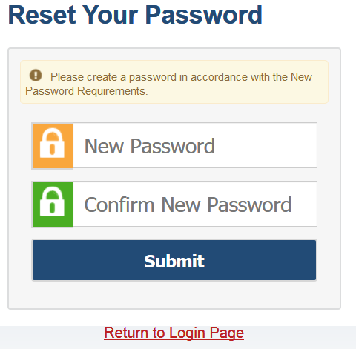
Activating Your TIDE Account
Follow the activation link in your email.
Create a password for TIDE that meets the password requirements.
At least 8 characters
At least 1 uppercase letter
At least 1 lowercase letter
At least 1 special character
At least 1 number
Submit your new password.
Notes:
When your TIDE administrator first adds you to TIDE, you will receive an account activation email that contains a temporary link to reset your password. The email contains two important links: an activation link, and a second link to request a new activation email. The activation link is valid only for 15 minutes. After that time, the link will expire, and you will need to click the second link to request a new activation email. When you click the activation link, the Reset Your Password page will appear. Create the password you will use to access TIDE. If the password you enter is not processing, please ensure that you have met all system password requirements.
If you do not reset your password, you will not be able to access the system. If your password meets all requirements, click Submit. If you do not receive an activation email, check your spam folder.

Slide 4
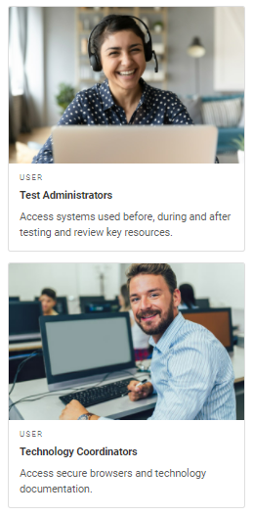
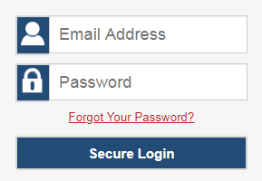
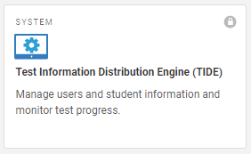
Logging in to TIDE
User Role Card
Login Screen
TIDE Card
Notes:
To log in to TIDE, go to your portal. Click the appropriate user role card. On the next page, click the TIDE system card. Enter the username and password you created when activating your account. Then click Secure Login to go to the TIDE home page.

Slide 5
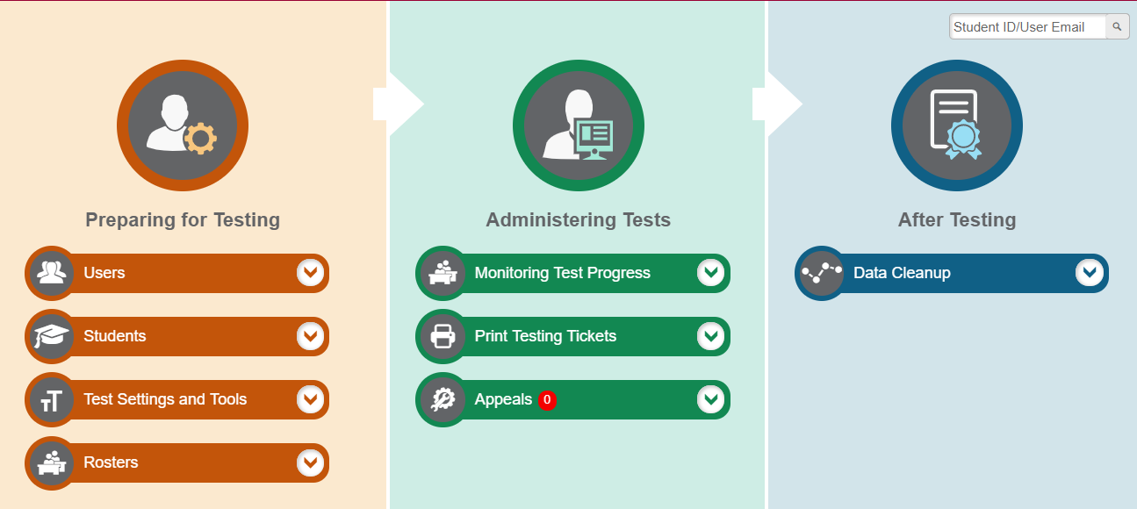
TIDE Home Page
Notes:
The TIDE home page appears after you log in. The home page is designed to reflect the stages of the testing process as directly and simply as possible. Each of TIDE’s three sections lists menus for the tasks available in that section. For example, the Users menu contains options for viewing and exporting users. To expand a task menu and view its set of related tasks, click the down arrow on the end of that menu. To perform a task, click the name of that task listed in the menu.

Slide 6
Overview of TIDE Tasks: Preparing for Testing
Notes:
Tasks in the Preparing for Testing section are typically performed before testing begins. This category includes tasks for managing records for users, students, test settings, and rosters, depending on your state program.
TIDE can group students into rosters. A roster is a collection of students sharing a similar characteristic who are assigned to a specific teacher. Rosters typically represent classrooms but can also be used to group students with special needs or students participating in particular activities or programs. Rosters are helpful for users who want to view participation reports for a group of students. Additionally, once scores are calculated, users can visualize how a roster of students performed as a group. However, students do not need to be in a roster to take a test.

Slide 7
Overview of TIDE Tasks: Administering Tests
Notes:
Tasks in the Administering Tests section are typically performed during the administration window.
Test administrators may use TIDE to invalidate a test, reset a test, or reopen a test.
TIDE can also be used to monitor test progress and generate test participation reports.

Slide 8
TIDE Tasks: After Testing
Notes:
The After Testing section allows users to perform data clean-up operations. This section does not pertain to the Screener and is outside the scope of this training module.

Slide 9
TIDE Banner
Notes:
A banner appears at the top of each TIDE page.
On the left there is a drop-down list for accessing other applications. You will also find a Help button that displays the TIDE User Guide, a Secure File Center button, and an Account drop-down menu. The TIDE User Guide can also be accessed through the Resources section of your state’s portal.

Slide 10
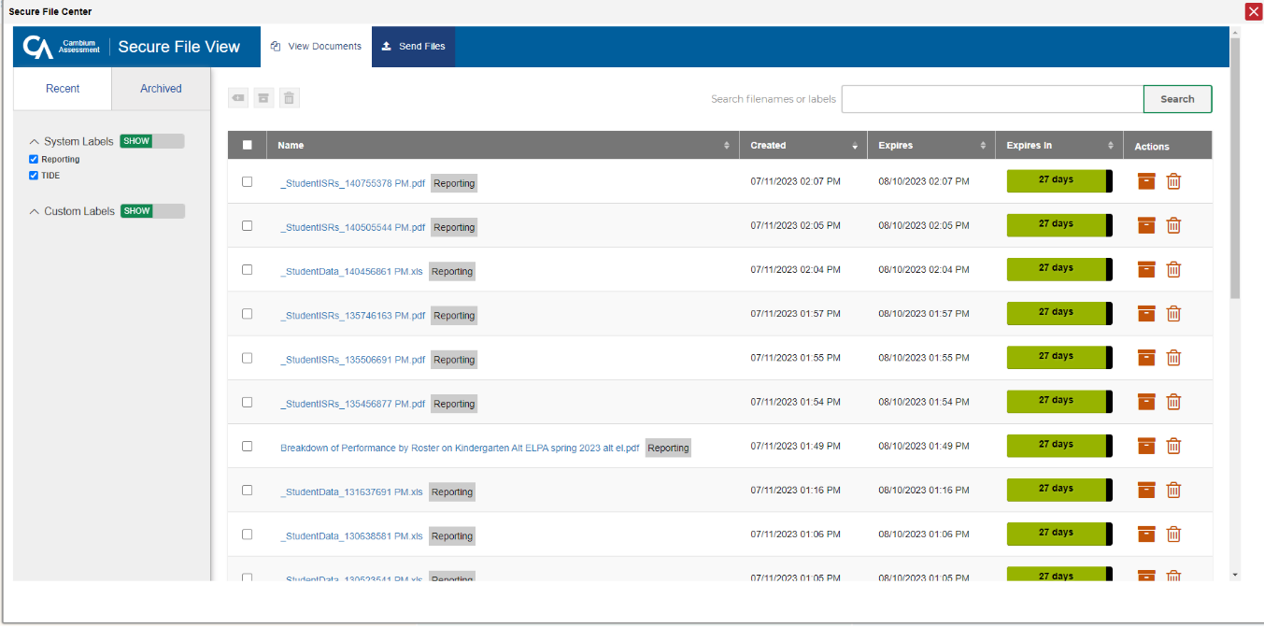
TIDE Banner: Secure File Center
Notes:
To access secure documents and student data files you have previously exported in TIDE, click the Secure File Center button in the banner. From the Secure File Center, you can download, archive, or delete previously exported files. For more information on this feature, see the TIDE User Guide.

Slide 11
TIDE Banner: Account
Notes:
The Account drop-down list allows you to change the role you are using in TIDE (if you have been assigned multiple roles), update your contact information (if your state allows), or reset your password.

Slide 12
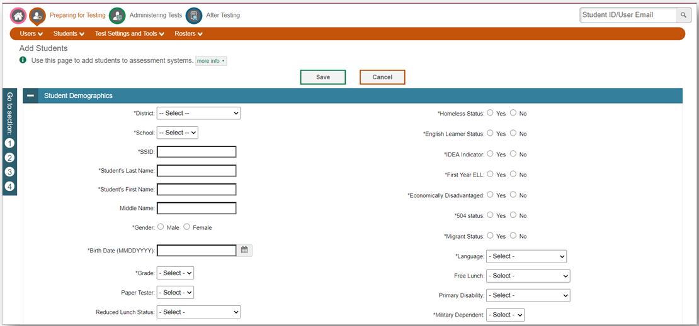
Navigation Toolbars
Notes:
When you enter any task page, a navigation toolbar appears at the top of the page. This toolbar allows you to access each task and action that was available on the dashboard. To view the task menus for a particular TIDE category, click the icon for that category above the toolbar.
Some pages in TIDE are divided into multiple panels. Each panel contains a group of related settings and fields that you can edit. You can click the minus sign in the upper-left corner of a panel to collapse it or click the plus sign in a collapsed panel to expand it. Additionally, a floating Go To Section toolbar appears on the left side of pages with multiple panels. This toolbar includes a numbered button for each panel in the form. You can hover over a button to display the label of the associated panel and click the button to jump to that panel.

Slide 13
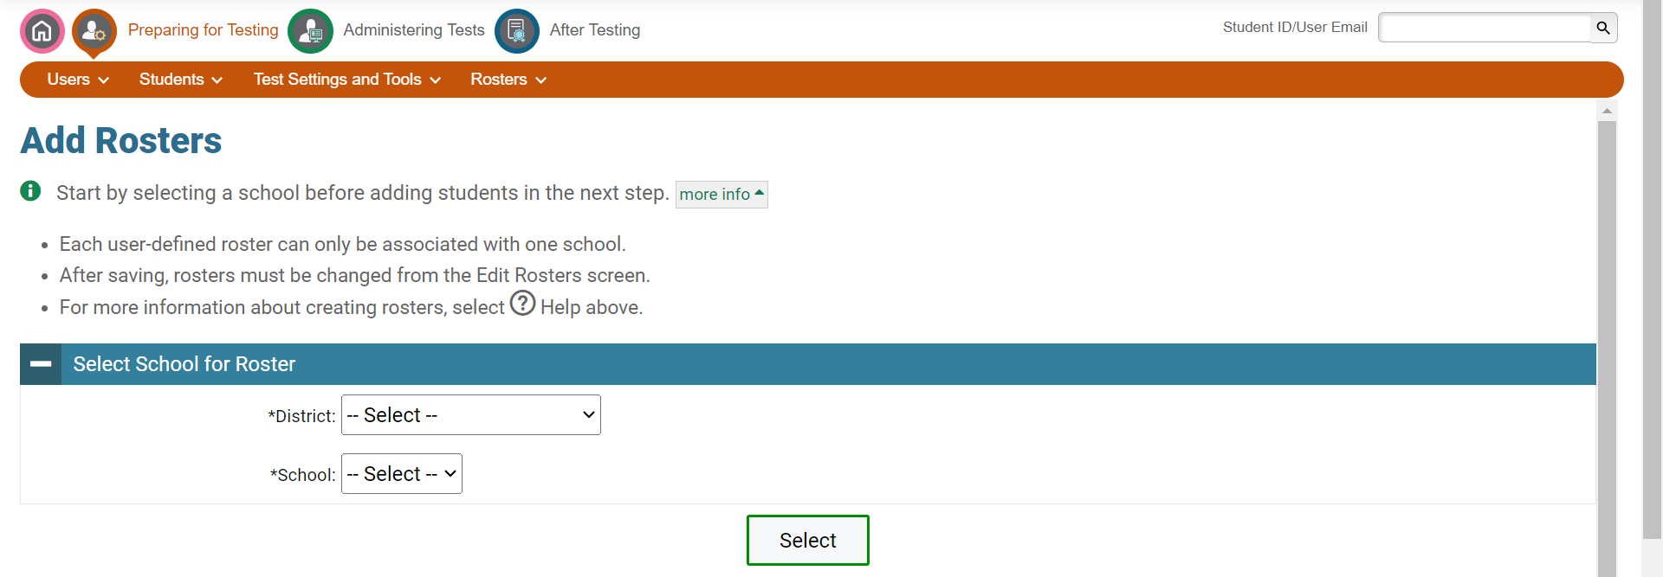
Help Text
Notes:
Most pages in TIDE have help text that describes the page and how to use it. To show or hide detailed help text on a page, click the gray More Info link under the page title.

Slide 14
Thank You!
For additional information, consult your state portal, which contains:
Important announcements
TIDE User Guide
For further assistance, please consult your state’s Help Desk.
Notes:
Thank you for viewing this training module. For additional information, refer to your TIDE User Guide located on your state’s portal. You may also wish to view additional resources available on the portal.
If you have general questions or need further information, please consult your state’s Help Desk for assistance.

