Slide 1
Test Delivery System (TDS) Overview
Summative Training Module
Copyright © Cambium Assessment, Inc. All rights reserved.
Notes:
In this training module on the Test Delivery System, or TDS, we will cover the basics of online administration of the ELPA21 summative assessments. For information regarding the ELPA21 screener assessment, refer to the TDS Overview training module for the screener located on your state’s portal. For information regarding the Alt ELPA assessment, refer to the TDS Overview training module for the Alt ELPA located on your state's portal.
Please note that the example images shown in this training module may vary slightly from your state’s system. For example, additional options may appear in the system if other assessments are available in your state. Additionally, test names may vary from one state to another. Apart from these surface-level differences, the following processes and functions are accurate for all states administering ELPA21 summative assessments.

Slide 2
Objectives
After viewing this presentation, you should be able to:
Use the Test Administrator Interface to start and run a test session;
View student test settings and accessibility resources;
Monitor the testing process;
Pause and stop a test session;
Print test session information;
Exit and log out of the Test Administrator Interface.
Notes:
The Test Delivery System (TDS) includes the Student Interface used by students to navigate through the test, and the Test Administrator (TA) Interface used by TAs to manage test sessions and monitor student testing progress.
After viewing this presentation, you should be able to:
Use the Test Administrator Interface to start and run a test session;
View student test settings and accessibility resources;
Monitor the testing process;
Pause and stop a test session;
Print test session information; and
Exit and log out of the Test Administrator Interface.
The procedures for administering operational tests and practice tests using a TA session are identical. However, students must use the Secure Browser to take an operational test. They can take a practice test using either the Secure Browser or a supported non-Secure Browser. The Supported Browsers page on the portal lists the non-Secure Browsers that can be used for student practice tests.
We strongly recommend that all test administrators administer a practice test before they administer an operational test. Two test administrators may want to work together while doing this for the first time, with one test administrator as the teacher and one as the student. Students should always take a practice test to become familiar with the software before they take an operational test.

Slide 3
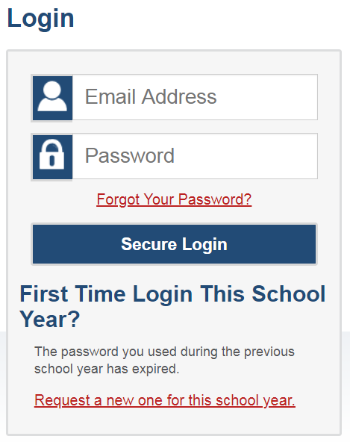
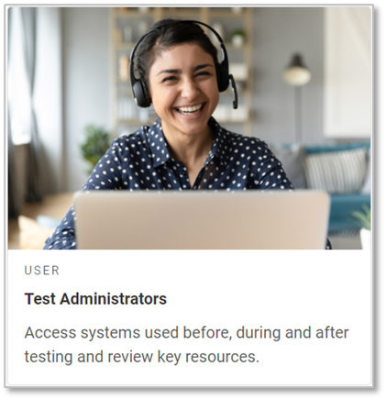
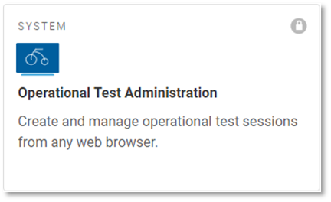
Logging in to the TA Interface
Notes:
The TA Interface is used to create and manage test sessions that students join to complete online tests. To log in to the TA Interface, go to your portal. Click the appropriate user role card. On the next page, click the system card used for operational or practice test administration. Enter your username and password, and then click Secure Login to continue.
There will be separate system cards for operational tests and practice tests.

Slide 4
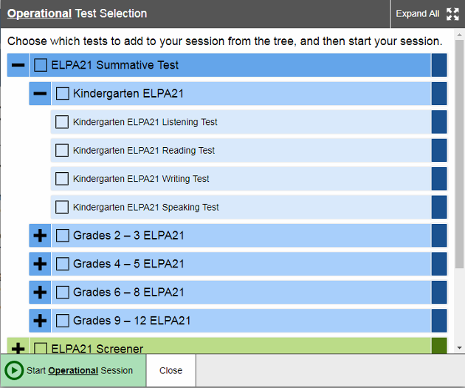
Test Administrator Interface: Overview
Notes:
Once the Test Administrator has logged in according to the directions on the previous slide, they will see the Test Administrator Interface with the Test Selection window open by default. From the Test Administrator Interface, you can access the features you need to create and manage test sessions, look up students, and access help information.
When a user first logs in to the Test Administrator Interface, the Test Selection window appears automatically. This window closes when the Test Administrator starts the session.

Slide 5
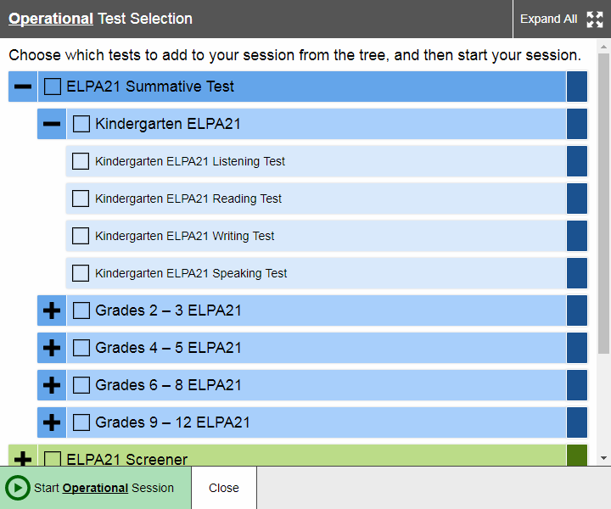
Create a Test Session
Notes:
The first step in administering a test is to create a test session. This should be done less than 20 minutes prior to starting the test in order to prevent the system from timing out. The list of students in the session will generate automatically when the students log in to the session.
You can create test sessions in the Test Selection window that appears when you log in. You can click the Plus Sign button next to a category name to view the tests in that category. To create a test session, click one or more tests to administer. You may select all available tests listed, for all grade levels and all content areas. Students will only have access to the tests you select for them that they are eligible to take.
Once you select your tests, the Start Session button in the lower-left corner of the window activates. Click the Start Session button. Please note, the exact name of this button may vary depending on whether the TA is in the practice test administration site or the operational test administration site. The system will automatically generate a session ID. This ID must be provided to students in order for them to log in. The Test Administrator may write it on the board or provide it to students using a printed card or similar method. If you do provide students with the information on paper, be sure to collect and destroy it when the session is complete.
You should also note the session ID for your own records. If you are involuntarily logged out of the session due to an inactivity timeout or other event, entering the session ID will allow you to resume the session. If you do not have this information when you try to resume, you will be unable to do so.

Slide 6
Test Administrator Interface: Overview (continued)
Notes:
When a user first logs in to the Test Administrator Interface, the Test Selection window appears automatically. This window closes when the Test Administrator starts the session.
After starting a session, the session ID appears at the top of the Test Administrator Interface along with a Stop button. When students start signing in to the test session, an Approvals button also appears next to the session ID. Once the Test Administrator approves students for testing, the Test Session table appears in the center of the Test Administrator Interface, displaying students’ testing progress.
Additional features are available in the banner at the top of the screen.

Slide 7
TA Interface: Banner
Notes:
At the top of the screen, you will see a set of buttons and your username.
You can click Student Lookup to search for student information and verify that the student’s login credentials are correct.
Click Help Guide to access additional information about the TA Interface.
Click Approved Requests under Menu to view a list of student print requests that you approved during the test session.
Click Print to print a screenshot of the TA Interface.
Click Logout under your username when you want to exit the TA Interface.

Slide 8
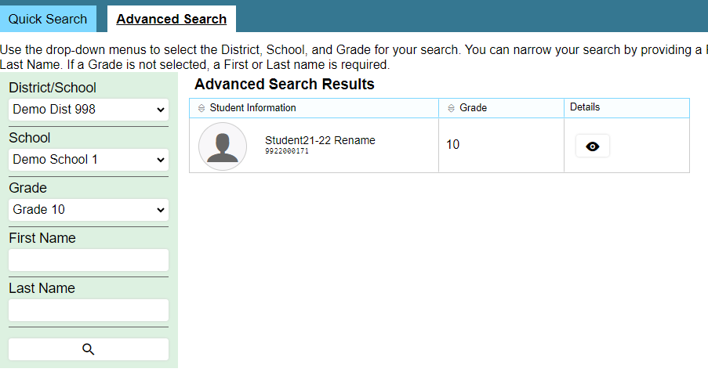
Student Lookup
Notes:
If a student is having trouble logging in, use the Student Lookup feature to verify that the student’s login credentials are correct. You can use either the Quick Search or Advanced Search option to view the information entered for the student in the Test Information Distribution Engine (or TIDE). With Quick Search, you simply enter the student’s state-assigned student ID and click the Submit SSID button. Advanced Search allows you to narrow your search using several filters, including District/School, Grade, and First and Last Name.
When using either Quick Search or Advanced Search, if the search results in matches, the information will appear in the bottom of the window. If there is no match, you will see an error message.

Slide 9
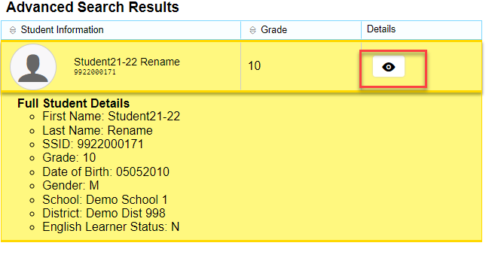
Student Lookup
Notes:
If you see the student you are looking for, click the Eye button next to the student’s name. A new window displaying the student’s information will display. Note that the information displayed may vary slightly from what is shown here.
Next, we will look at what students see when they log in to take a test.

Slide 10
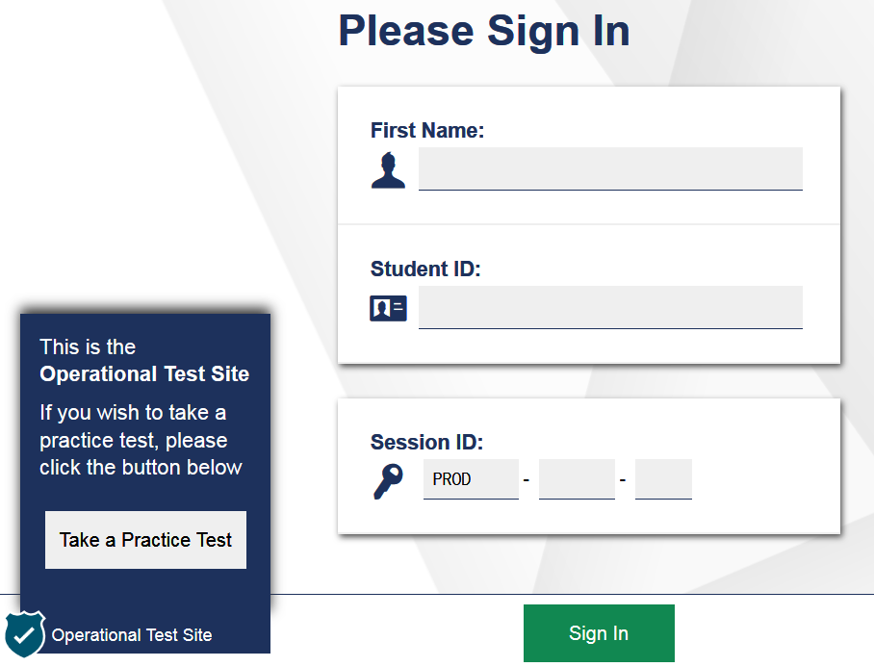
Student Login
Notes:
To log in to the online testing system using the secure browser, students must enter three pieces of identifying information: their first name, their SSID, and the current session ID. Only the session ID is unique for each test administration and each proctor, so this is the only information that will change through this test window. TIDE allows teachers to print out student information on “Test Tickets” so students can log in to the online testing system without needing to memorize their SSID number.
When entries are complete, students will click the Sign In button to log in to the test. The Test Administrator may assist students with logging in, if necessary.
The session ID is generated when the Test Administrator creates the test session. It needs to be given to students by the Test Administrator when it is time for them to log in to the test. Session IDs should not be generated more than 20 minutes before students are ready to log in.
Students log in to the practice test following exactly the same procedures. More information is provided in the Test Administrator Manual (or TAM) which will be posted on the state portal when the practice tests open.

Slide 11
Login Errors
Issue | Error Message | What to Do
Student first name and SSID do not exactly match what is in the system. | Please check that your information is entered correctly. If you need help, ask your Test Administrator. | Verify that the student has entered the correct first name and exact SSID. You may need to use the Student Lookup Tool, which is located in the Test Administrator Interface, to verify that the student is in the system.
Student enters the session ID incorrectly. | The session is not available for testing. | Verify that the student has entered the correct Session ID with no extra spaces or characters.
Student enters a session ID for an incorrect or expired session. | Session has expired. | Ensure that the student enters the correct Session ID for the current session. If this does not work, verify that your session is open using the Test Administrator interface.
One person (either the TA or the student) is using the Operational Test Administration Site, and the other is using the Practice Site. | The session is not available for testing. | If taking a practice test, make sure that you and the student are both on the Practice Site. If taking an operational test, make sure the student is using the Secure Browser, and you are using the Operational Test Administration Site.
Notes:
If a student is having difficulty logging in, an error message and code will display on the login screen. The most common errors occur when the student’s first name and SSID do not match what is in the system and when SSIDs are entered incorrectly. If the student receives an error message indicating that they have entered incorrect information in the first name or SSID fields, the TA should use the Student Lookup Tool in the TA Interface to verify the student’s information.
Another common error occurs when the student enters an incorrect session ID. If a student receives the message “The session is not available for testing,” verify that the session ID was entered correctly, with no extra spaces or characters. The session ID can be found in the TA Interface. If a student receives the error message “Session has expired,” ensure that the student has entered the correct session ID for the current session. If the student has entered the session ID correctly, use the TA Interface to verify that your session is still open.
Finally, if administering a practice test, make sure that the TA and the student each use the appropriate practice and training test site. If administering an operational test, ensure that the TA is using the Test Administration site, and the student is using the Secure Browser.

Slide 12
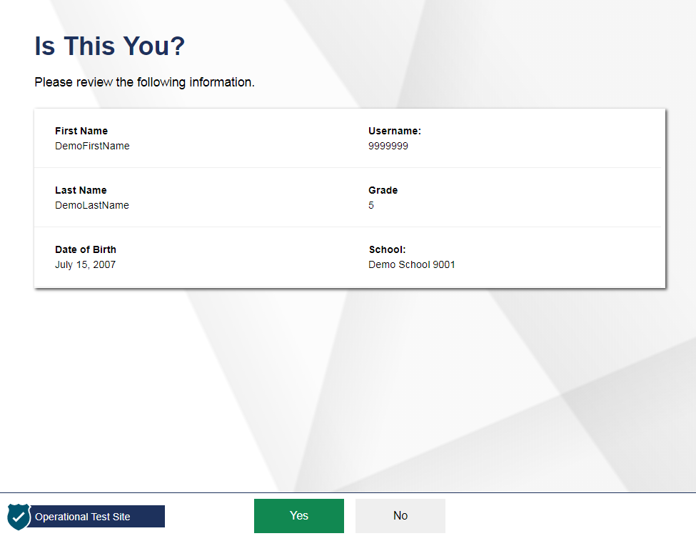
Student Login and Test Selection
Notes:
After logging in, students need to complete a few more steps before they begin testing. Students will be asked to view and verify their personal information. If their information is correct, students should click Yes to proceed. If their information is incorrect, they should click No to return to the login page. Test Administrators must then contact their Building or District Test Coordinator to have the student’s information updated in TIDE before the student attempts to log in again.

Slide 13
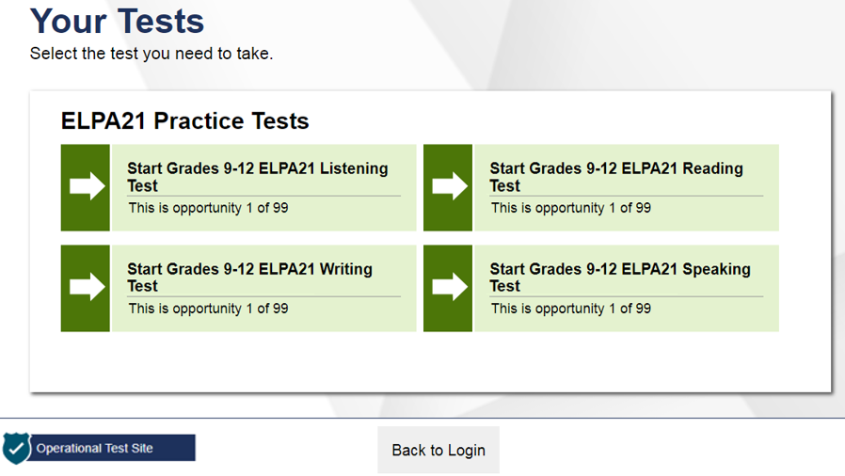
Student Login and Test Selection, continued
Notes:
On the “Your Tests” screen, students will see a list of their assigned tests for this test session. ELPA21 has separate tests for reading, writing, listening and speaking. TAs should only include the tests that they want the students to take in the test session.
If the test displayed is incorrect, or the expected test is not listed, students should click the Back to Login button to return to the login page and consult the Test Administrator to resolve the issue. If a test has already been completed, the test selection button will be grayed out. If there are no errors, students should select the correct test and wait for the Test Administrator approval to proceed.
Once students select a test to take, they must wait to be approved by their TA.

Slide 14
Approving Student Entry
Notes:
Let’s return to the Test Administrator Interface, which shows all students in the session who are ready to start their test.
Once the Test Administrator starts the test session and students log in, they must approve students’ test settings before they can access their tests. It is very important to pay close attention to the test name prior to approving to be sure that students selected the appropriate test. You can do this by clicking the Approvals button. A list of students will display, organized by test name. The Test Administrator should review the list to make sure that all students chose the correct content area and test. The Test Administrator should also ensure that all student settings are correct. This is done using the Eye button in the See Details column. See the TIDE User Guide for more information about test settings.
If no changes are needed, click the green check mark next to a student’s name to approve that student. Click Approve All Students to admit all students to the session. If a student selected an incorrect test, you must deny that student entry to the test session by clicking the X button in the Action column.

Slide 15
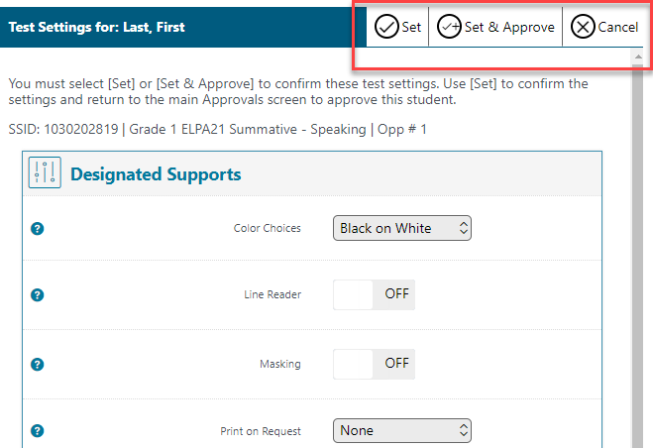
Approving Student Entry, continued
Notes:
When you click the Eye button, a popup window will appear that allows you to verify that the student has the correct test settings and make changes to them, if necessary. See the TIDE User Guide for more information about test settings.
Once you have confirmed that the student’s test settings are correct, click Set to save the changes and return to the main approvals window, or click Set & Approve to save changes and approve the student’s entry into the test session.
If no changes are needed, click the green check mark next to a student’s name to approve that student. Click Approve All Students to admit all students to the test session. If a student selected an incorrect test, you must deny that student entry to the test session by clicking the X button in the Action column.

Slide 16
Denying Student Entry
Deny entry to a test session in these circumstances:
The student is not supposed to enter this session.
The student’s demographic information is incorrect.
The student’s required accommodations are incorrect.
Notes:
Although you can approve all students at the same time, students must be individually denied entry into the test session.
The Test Administrator should deny students entry into the session in these circumstances:
The student is not supposed to enter this session.
The student’s demographic information is incorrect.
The student’s required accommodations appear to be incorrect, and the TA needs to gather more information.
Denying the student entry into the test session will not prevent other approved students from beginning their tests.
If the student’s test settings are incorrect, the settings can be updated in TIDE or in the TA interface before the student takes the test.
Note that no settings can be changed while the student is actively testing. The student must pause the test and log out if necessary to change the student’s test settings. Once the student is no longer actively testing, the student’s test settings can be updated in TIDE.

Slide 17
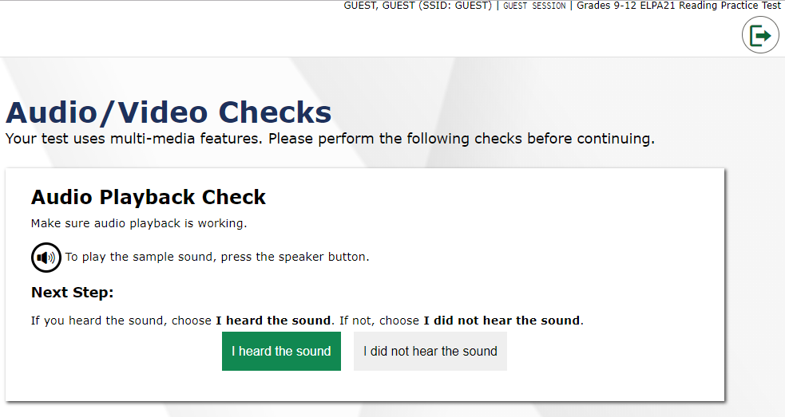
Audio Playback Check
Notes:
Be sure that all students taking ELPA21 tests have headphones. After selecting a test requiring audio, students will see an “Audio/Video Checks” page. They will be prompted to click the sound icon and indicate whether the sound was audible by choosing either the I heard the sound or I did not hear the sound button.
If students click “I heard the sound”, they will proceed to the test. If they click “I did not hear the sound”, they will receive a message advising them to tell the Test Administrator that they are having an audio problem. From there, they can click Try Again to listen to the sample audio again or click the Logout icon at the top-right corner of the page to leave the test and work with the Test Administrator to adjust their audio settings.

Slide 18
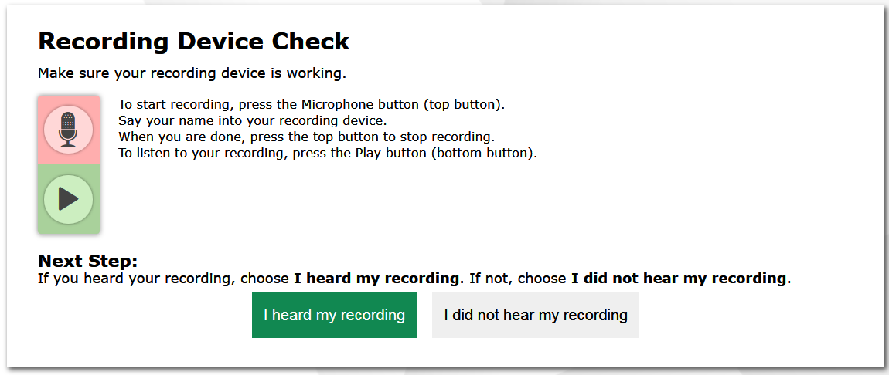
Recording Device Check
Start/Stop Recording
Start/Stop Playback
Notes:
Be sure that all students taking ELPA21 Speaking tests have headphones and microphones. Preferably, students will be equipped with headsets that have built-in microphones.
After verifying the test audio is functioning, students taking ELPA21 Speaking tests will need to verify their microphones are functioning as well. First, they should click the microphone icon on this screen.
After clicking the microphone icon, the icon below the microphone will display a stop button. Students should say their names into their microphones, and then click the stop button.
When students click the stop button, the icon will be replaced with a green play button. Students should click the play button to hear their recording.
If students clearly hear their names, they should click the I heard my recording button to proceed to the test.
If the audio is not clear, students should click the I did not hear my recording button and receive a message advising them to tell the TA about the microphone problem. From there, they can click Try Again to record an audio sample again, click Select New Recording Device to try recording using a different attached audio device, or click Logout to leave the test and work with the Test Administrator to adjust their microphone settings.
TAs are permitted to assist students with test navigation, including these record and playback buttons, throughout the test, but ensuring that students get to practice ahead of time usually means they can navigate the test on their own.

Slide 19
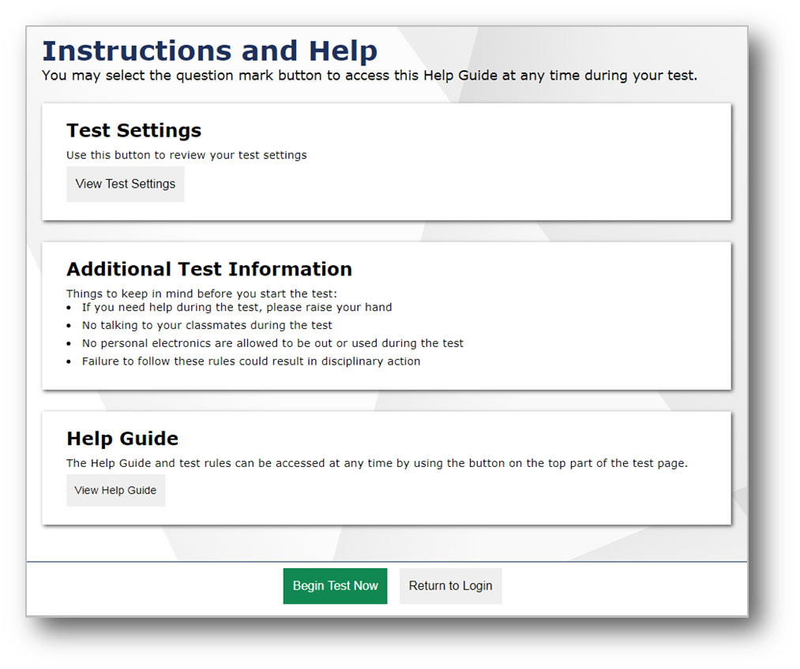
Test Instructions and Help Screen
Notes:
After confirming that their microphones are working, students will see the Test Instructions and Help screen.
When students click View Test Settings they will be presented with the Review Test Settings screen where they can review their test settings.
When students click Begin Test Now, they will be presented with the first question of the test.

Slide 20
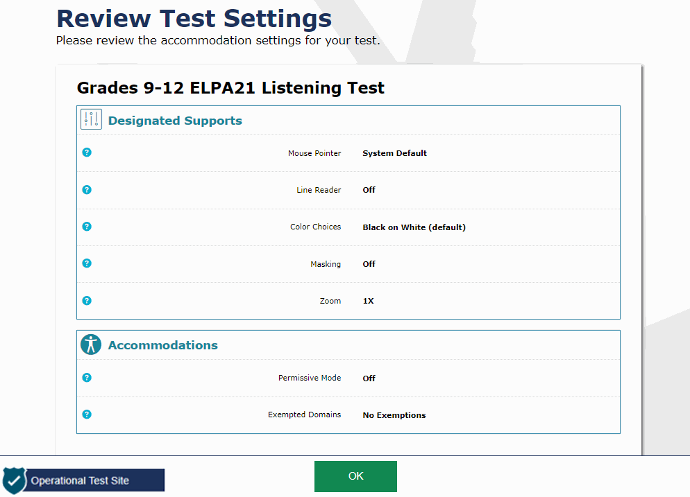
Student Test Settings
Notes:
The “Review Test Settings” screen displays the name of the test and whether or not any accessibility resources have been selected. If the information is correct, students should select “OK”. Note that the actual settings students see may vary from what is shown on this slide. Be sure to refer to the scripts located in the Test Administration Manual to guide students through the login and confirmation process.

Slide 21
Tools in the Student Testing Site
Questions Drop-down Menu
Navigation Buttons
Test Tools
Notes:
Now we will review how students navigate the student interface and use test tools. The global menu appears at the top of the Student Interface. The left side of the menu contains navigation buttons that students use to advance through the test.
All students can navigate between pages using the Back and Next arrow buttons. Students can also navigate between items using the Questions drop-down menu located above the navigation buttons. The Save button ensures that a response is committed to the system. However, the Save button is not required to save an item. Other actions, such as moving forward to the next question, will also save the response. The Pause button pauses a student’s test and logs the student out of the Student Interface.
The right side of the menu contains test tools that students may use during testing. Some test tools, such as the Zoom In and Zoom Out buttons, are universal tools available to all students.
The Masking tool allows students to “cover” an area of the item so they can focus on certain item elements. The Notes tool brings up an online notepad that students can use to type notes while testing. The Zoom Out and Zoom In tool allows students to decrease and increase the size of text and graphics on the page.
Other tools are designated supports or accommodations that must be set up in TIDE in order for students to use them. For more information on managing test settings and accessibility resources in TIDE, refer to the TIDE User Guide. For a detailed list of all available test tools and accommodations, including non-embedded accommodations, please consult the Accessibility and Accommodations Manual on your state’s portal.
Finally, students can access the Test Instructions and Help page at any time by clicking the question mark in the upper-right corner of the toolbar.

Slide 22
Test Items with Audio
Many test items contain audio clips.
Audio will automatically play once the page with the item or stimulus loads.
Students can pause or replay audio by clicking the corresponding button.
Only one audio clip can play at a time.
Notes:
Many test items contain one or more audio clips. The audio will automatically play once the page with the item or stimulus loads. Students can pause the audio or replay the audio clip by clicking the corresponding button.
Note that only one audio clip can play at a time. In order to play a different clip, students must pause the clip that is currently playing.

Slide 23
Test Items with Multiple Elements
Note that some stimuli have several elements.
Students will see navigation buttons below this type of stimulus.
The arrow buttons allow the student to move between stimulus elements.
Notes:
Note that some stimuli have several elements. Students will see navigation buttons below this type of stimulus. The arrows allow the student to move between the stimulus elements. Students can also play and pause audio, as needed.

Slide 24
Speaking Items
The process for recording a speaking response mirrors the steps the student takes during the microphone check process.
Press the microphone to start recording.
Click the stop button when finished speaking.
Click the green play button to listen to the response.
If needed, click the microphone again to re-record the speaking response.
Start/Stop Recording
Start/Stop Playback
Notes:
The process for recording a speaking response mirrors the steps the student takes during the microphone check process.
Press the microphone to start recording.
Click the stop button when finished speaking.
Click the green play button to listen to the response.
If needed, click the microphone again to re-record the speaking response.
If students re-record, their previous recording will be deleted. It is not possible to add to a recording after the student stops recording. If the student wants to add additional information the student must start over and record the entire response from the beginning.

Slide 25
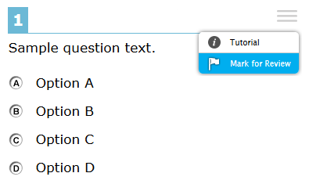
Context Menus
Context menus allow students to:
Mark items for review
View item tutorials
Send print requests to the TA (if available)
Access additional features depending on test settings and item types
Notes:
Some test items and stimuli contain context menus. Students may use context menus to mark items for review, view item tutorials explaining how a particular item type works, send print requests to the TA (if test settings and state policy allow), and access additional test features.

Slide 26
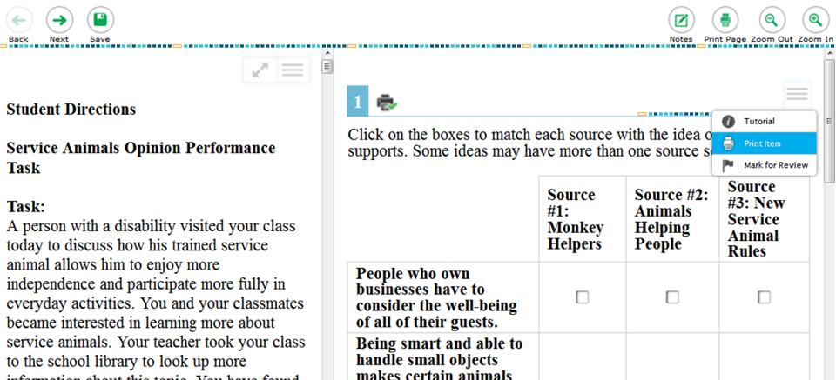
Print on Request
Notes:
Print on Request will only be available in states that allow this feature. Authorized users should review the Accessibility and Accommodations Manual posted in the Resources section of the portal for information regarding which students are eligible to use this test setting as well as all the available test settings.
Depending upon whether they are allowed to print items, passages, or both, students with this accommodation will see either a Print Page button at the top of the screen, a Print Item option in the context menu, or both. When a student clicks either Print option, the TA will receive a request for approval. We will discuss how TAs approve print requests later in this presentation. The student will see a pop-up message that indicates that the request for approval has been sent.
Test items that students have requested to print will display with a small printer badge next to the item number.

Slide 27
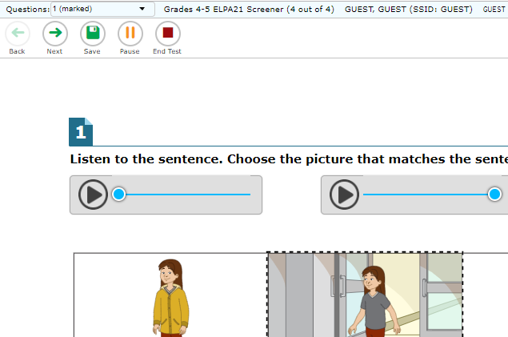
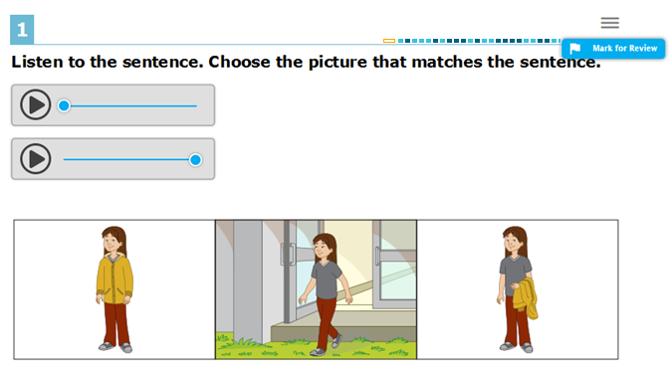
Mark Items for Review
Notes:
To flag an item for later review, students select Mark for Review in the context menu.
After marking an item for review, the drop-down navigation menu will show “(marked)” next to the item number.
Additionally, the item number at the upper-left of the item will appear with a folded corner.

Slide 28
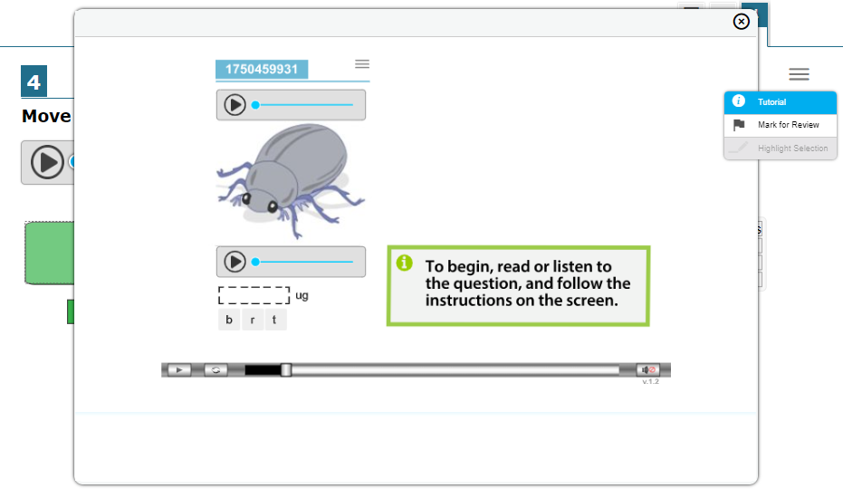
Item Tutorial
Notes:
To get more information about a particular item type, students can select Tutorial from the context menu. A pop-up message will appear that shows how that type of item works (for example: whether they should select an answer, drag-and-drop answers, or type a response in an answer space).

Slide 29
Pause and Test Timeout
Pausing a Test
Students returning to a paused test during the test window can finish their test, revisit any items, and change their answers if desired.
Test Timeout Due to Inactivity
As a security measure, after 20 minutes of test inactivity, students are logged out and their tests are paused automatically.
Inactivity is determined by whether the student is interacting with the test by selecting answers or using navigation tools.
Students will receive a warning message prior to being logged out and must click OK on the pop-up message within 30 seconds in order to avoid automatic logout and pausing of their test.
Notes:
As a security measure, after 20 minutes of test inactivity, students are logged out, and their tests are paused automatically. Inactivity is determined by whether or not the student is interacting with the test by selecting answers or using navigation tools. Students will receive a warning message prior to being logged out and must click OK on the pop-up message within 20 seconds in order to avoid automatic logout and pausing of their test. If a student’s test is paused, the student can log back in at any time during the test window to resume testing and change answers.

Slide 30
Screen Savers
If a screen saver is activated during testing, the security breach feature will log the student out of the test.
To avoid any such interruption, schools should either:
Deactivate screen savers before students start testing, or
Ensure that screen savers are set to more than the allocated testing time.
Notes:
Additionally, if a screen saver is activated during testing, the security breach feature will log the student out of the test. To avoid any such interruption, schools should either deactivate screen savers before students start testing or ensure that screen savers are set to more than the allocated testing time.

Slide 31
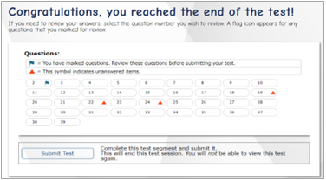
Ending a Test
Notes:
When students answer the final question on their test, the review Page will appear, along with a message advising them that the test has been completed. On this page, students may click any item to review it and change their answer. Unanswered questions are identified with an orange triangle icon, and questions flagged for review are identified with a blue flag. While reviewing items, students may return to the review page at any time by clicking the review button under the items drop down menu. Students who are ready to submit their tests should click Submit Test to finish.

Slide 32
Submitting a Test
Notes:
After clicking the Submit Test button, students will receive a pop-up message asking if they are sure they want to submit. Clicking No will return them to the review screen. Clicking Yes will take them to the end screen, which shows a message indicating that the test was successfully submitted and advising the student to log out.

Slide 33
Monitoring Student Status
Notes:
While students are taking their test, their test administrator can monitor their status from the Students in your Operational Test Session table on the TA interface. The table shows Student Name, SSID, Opportunity Number, Test Name, Test Status, Test Settings, and an Actions column.
The Test Status column indicates the student’s progress through the items in the test. It shows the total number of items completed thus far and the total number of items in the test. If the tests are segmented, the Test Status column may also indicate the segment ID, if this feature is enabled.
The Test Settings column will display either Standard or Custom. This column displays Custom when a student’s test settings are different from the default settings for that test. Click the Eye button to view a student’s test settings.
The Actions column displays a notification when students request a printout or pause a test.

Slide 34
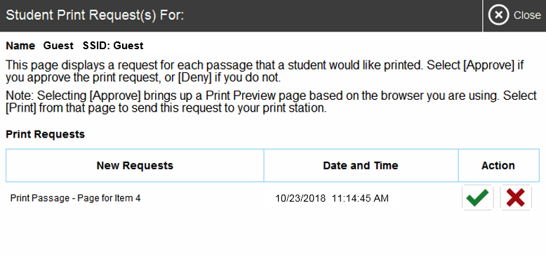
Print on Request
Notes:
Students with a Print on Request accommodation can request printouts of stimuli and/or items, depending on their settings.
When a student sends a print request, the Printer button will appear in the Requests column on the Test Administrator’s monitoring screen. Click the button to view the request.
If you click the Check button to approve the print request, a cover sheet containing the student’s name and SSID will display in a new browser window. No test content will ever display on your screen.
Click Print in the new window to complete the print request. A printer dialog box will display.
Click OK to send the request to the printer.
If you click the X button to deny the print request, nothing will be printed.
Before approving the student’s print request, ensure that it will be sent to a printer that is monitored by staff who have been trained in test security. All printed test items, stimuli, and reading passages must be securely stored and destroyed immediately following a testing session.

Slide 35
Test Administrator Interface: Approved Requests
Notes:
The Approved Requests button allows the Test Administrator to view a list of every print request they approved during the current session. To print this list for your own records, click Print at the top of the Print Requests window.

Slide 36
Printing Test Session Information
Notes:
If you wish to print a snapshot of the Test Administrator Interface in its current view, click the Print Session button. This can be useful for tracking which students did not complete their tests and may need to be scheduled for another test session. It may be necessary to set the page layout to landscape or adjust the margins in the Print Preview screen in order for the list to fit on the page. Remember that any printouts containing personally identifiable student information must be securely stored and should be destroyed after use.

Slide 37
Pausing and Stopping Sessions
Pause an Individual Student’s Test
Affects only one student
Test session continues for all other students in the session
The student whose test is paused may rejoin the test session before it ends.
Stop Test Session
Affects ALL students in test session
All unsubmitted tests are automatically paused.
If a session stops, it cannot be resumed. You must start a new session if students need to resume testing.
Notes:
There are two options within the Test Administrator Interface to pause or stop testing once it has begun. You can pause an individual student’s test or stop the entire session. This slide lists some differences between the pause and stop functions. Note that if you stop an entire test session you will need to start a new session and students will need to log back in again in order to resume testing.

Slide 38
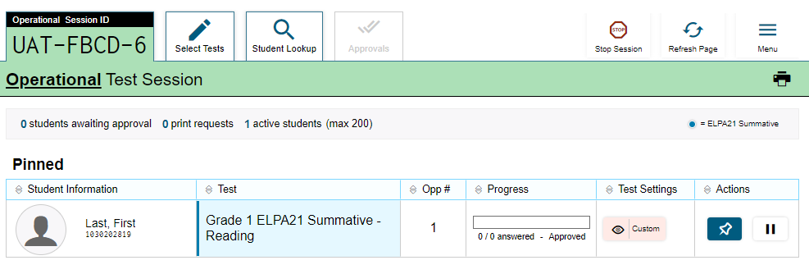
Pausing and Stopping Sessions
Notes:
To pause an individual student’s test, click the Pause button on the monitoring screen for that student. When prompted, click OK to confirm that you want to pause the test. This option would be appropriate if a student becomes ill, for example. In the event of an emergency that requires all students to stop testing, the Test Administrator can pause all students’ tests by stopping the session.
If you stop the session, all in-progress tests will be paused. If a session stops, it cannot be resumed. The Test Administrator will have to create a new session and give the new session ID to students so that they can resume testing. To stop the entire test session for all students:
Click the Stop button in the upper right corner of the screen. A pop-up message will appear requesting verification to end the session and log students out.
Click OK to continue.
If you forget to log out before leaving the testing area, the session will close automatically after 30 minutes of inactivity on both the Test Administrator and Student computers. The Test Administrator would then need to create a new session and provide the new session ID to students in order to resume testing.

Slide 39
Pausing and Stopping Sessions
Notes:
When the system detects that a student is no longer in a test session, an information icon will appear in the Actions column for that student. Click the ‘i’ button to view a description of the student’s status, including why the student is no longer in the test session.
This information can help you diagnose why a student has unexpectedly left a test session. The information that appears will tell you whether a student’s test has been paused due to the student clicking the Pause button, a session timeout, or some other reason.
For a full list of status descriptions that can appear during a test session, please consult the TA User Guide.

Slide 40
Logging Out of the Test Administrator Interface
Notes:
To log out of the Test Administrator Interface, click the Logout button in the upper-right corner of the screen. It is preferable to log out only after stopping your active test session, as logging out will cause all in-progress tests to be paused. A confirmation message will appear, asking you to confirm that you want to exit the site and pause all students’ in-progress tests. This scenario also occurs when you navigate to another site from the Test Administrator Interface. However, regardless of when or how you log out or navigate away from the Test Administrator Interface, student data will NOT be lost. If the Test Administrator needs to access another application, we recommend opening it in a separate browser window.
Click Yes to proceed. When all students have completed testing, refer to the Test Administration Manual for instructions on destroying any printed testing materials and reporting test improprieties or irregularities.

Slide 41
Troubleshooting
Description | What to Do
What should I do if a test session ends? | Log in and start a new session. Provide the students with a new session ID.
What should I do if a student gets logged out of a test while a session is still active? | If a student’s test session is interrupted, the student should log back in and rejoin the session.
What should I do if forbidden applications are running? | The secure browser will not allow the student to begin testing if forbidden applications are running. You will see messages advising you which applications must be closed before testing can begin.
What should I do if a student’s test freezes? | Force-quit the secure browser and log back in. For instructions, refer to the Test Administration Manual.
Notes:
This table presents some of the common issues that Test Administrators or students may encounter during a test session. Please take a moment to review this information. For more detailed information and additional technical tips, please refer to the Test Administration Manual and the technical resources for Technology Coordinators on the state portal.

Slide 42
Thank You!
For additional information, consult your portal’s Resources page, which contains:
Important announcements
TA User Guide
Accessibility and Accommodations Manual
For further assistance, please consult your state’s Help Desk.
Notes:
Thank you for viewing this training module. If you need additional information, please take some time to review the resources posted on the portal and sign up to receive notifications as additional resources are added to the portal.
For further assistance, please consult your state’s Help Desk.

