Slide 1
Reporting System
Training Module
Copyright © 2023 Cambium Assessment, Inc. All rights reserved.
Notes:
Welcome to the training module on the Reporting System. The Reporting System offers a user-friendly interface that provides teachers and administrators with results for Screener and Summative assessments in a single system.
This training module is based on the Reporting System User Guide, which is available on your state assessment portal. Please note that images in this presentation are for demonstration purposes, and the appearance of your state’s Reporting site may vary slightly.

Slide 2
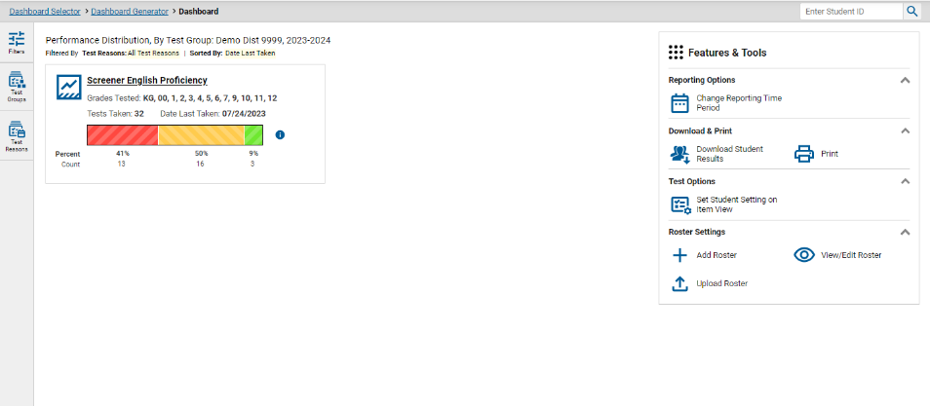
Purpose of the Reporting System
Simple, user-friendly and accurate
Provides information that’s readily accessible and easily digestible
Scalable—designed to handle lots of data and more features over time
Accessible on different devices and by different user types
Notes:
The Reporting System is designed with a user interface that is intuitive, user-friendly, accurate, scalable, accessible, and easily digestible. With the intent to provide the clearest picture with the fewest number of clicks, the system displays state, district, school, teacher, class, and student level data in tabular and graphical format. It is designed to handle lots of data for a variety of tests, and it will be continuously updated with more features over time. The system is accessible on different devices and by different users at the teacher, school, district, and state level. Users can sort and filter the data in various ways and can create custom groups to generate timely reports for intervention groups or incoming classes.

Slide 3
Objectives
After viewing this presentation, you will understand how to:
Log in to Reporting or Reset Your Password
Navigate Dashboard and Test Results Pages
Filter Your Data
Set preferences and filters
Use demographic sub-groups
Use the Student Portfolio Report
Generate Individual Student Reports (ISRs) for One or Multiple Students
Print and Export Any Data You Can View in Reports
Notes:
First, we will review how to log in to the Reporting System, and then we will cover how to navigate through the dashboard and test results pages. Filters will be explained so that you can eliminate unnecessary data from your reports. Next, we will review the demographic sub-group report and the Student Portfolio report. The webinar concludes with a section on printing ISRs, for one student or in batches, and printing and exporting reports.

Slide 4
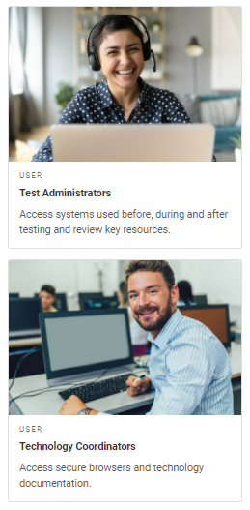
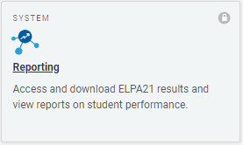
Logging in to Reporting
User Role Card
Reporting Card
Login Screen
Notes:
To log in to Reporting, you must have an authorized email address and password, which is the same as the one you use for TIDE and the TA Interface. Contact your School Administrator if you do not have a TIDE account.
Reporting is a secure, role-based system. Your access to reports and data in the system depends upon your user role and your district and school associations.
To log in to Reporting, go to your state portal. Click the appropriate user role or assessment card. On the next page, click the Reporting system card. Enter your username and password, and then click Secure Login.

Slide 5
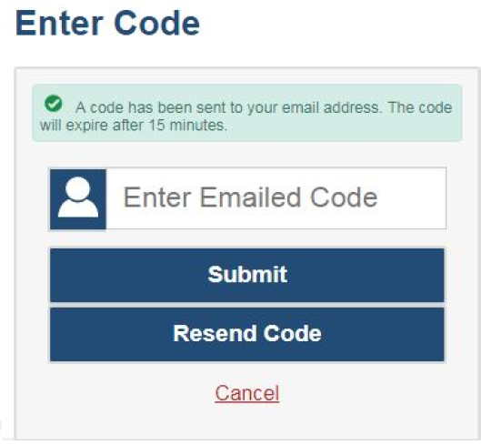
Logging in to Reporting (Continued)
The system has an authentication process that will be triggered when you log in from a different device or browser, or after clearing your browser’s cache.
If you see this screen, an email containing the code will have automatically been sent to your email address.
Enter the code and click Submit.
If you need the code resent, click Resend Code.
Notes:
When logging in to the system using a new device or browser, or after clearing the cache on a previously-used browser, you will see an Enter Code page. An authentication code will be sent to your email address, and you will need to enter the code on this page within fifteen minutes of receiving the email. If you do not receive a code or do not enter the code within the fifteen-minute time limit, click Resend Code. Click Submit after entering the authentication code to access the system.

Slide 6
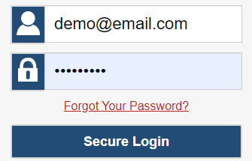
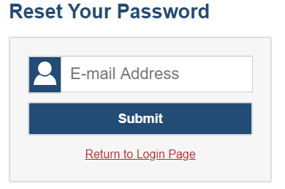
Resetting Your Password
Notes:
You will need to reset your password in the following situations:
You forget your password.
Your activation link expired.
Your account is locked because you exceeded the account login attempt limit.
It is a new school year.
To reset your password, click the Forgot Your Password? link. You will be taken to the Reset Your Password page. Enter your email address and follow the prompts to create and confirm a new password.

Slide 7
Dashboard Generator Page
Notes:
When you log in to the Reporting System, the Dashboard Generator page appears. The controls on the left let you select from the groups of tests that have been processed in your state for the school year. You may choose the test type, subject within the test type, and grades within the subjects.
To the right of the dashboard generation controls are some other useful features. The Looking for a specific student? section allows you to use student ID to view all that student’s test results. The Features & Tools menu appears on the right side of this page and in reports and offers multiple features.
After making your selections, click Go to Dashboard.

Slide 8
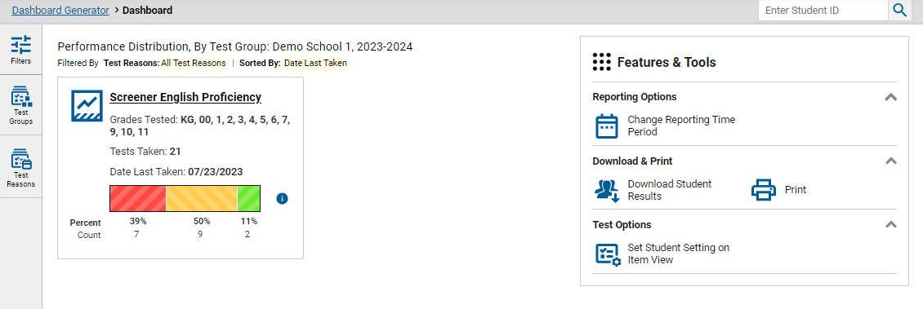
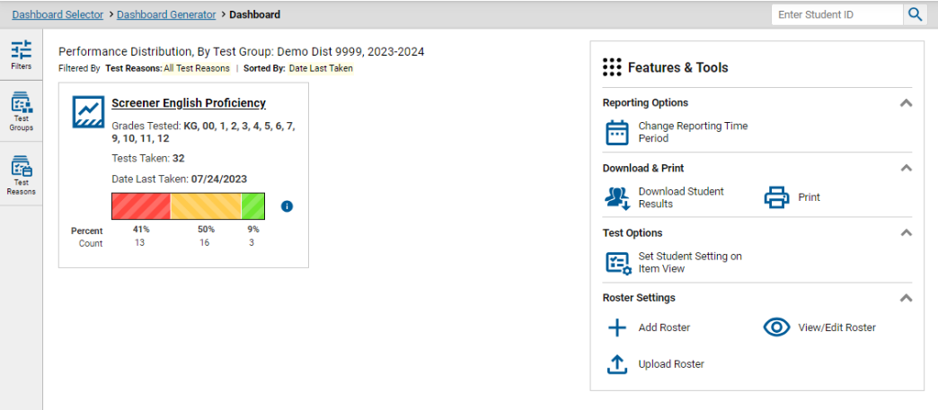
Dashboard Layouts
Teacher Dashboard
School & District Dashboard
All test results for all the teacher’s students
All test results for all the students in the school(s)
Notes:
After generating a dashboard, teachers and school- and district-level users see the dashboard landing page. Test information and results are displayed for the students assigned to you based on your role.
On each dashboard, users can sort and filter by specific categories and demographics so they can find data applicable to their needs. It only takes a few clicks to create a highly customized report, no matter the test type or the level of the user.

Slide 9
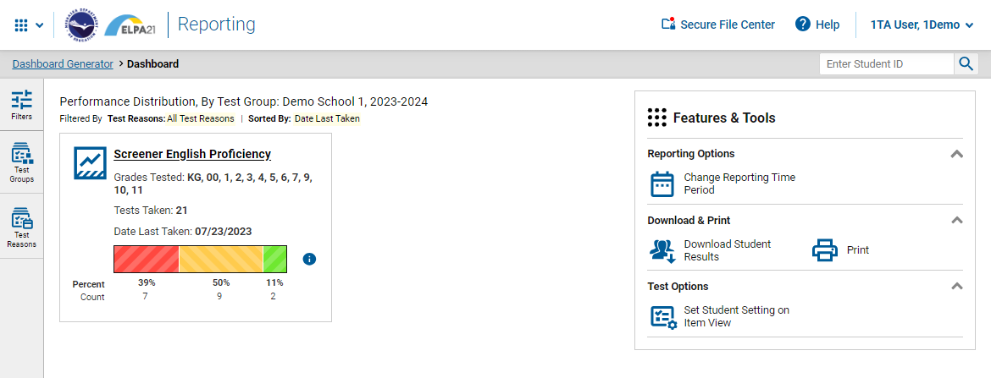
Dashboard Features: Buttons, Arrows, and Filters
Notes:
Test results and other data lie just under the surface of the dashboard page. Buttons, arrows, and test names are all “clickable.”
This slide shows the numerous clickable objects on the dashboard homepage. These buttons include but are not limited to the Secure File Center, the Help feature, the Student Search box, and the Features & Tools menu.

Slide 10
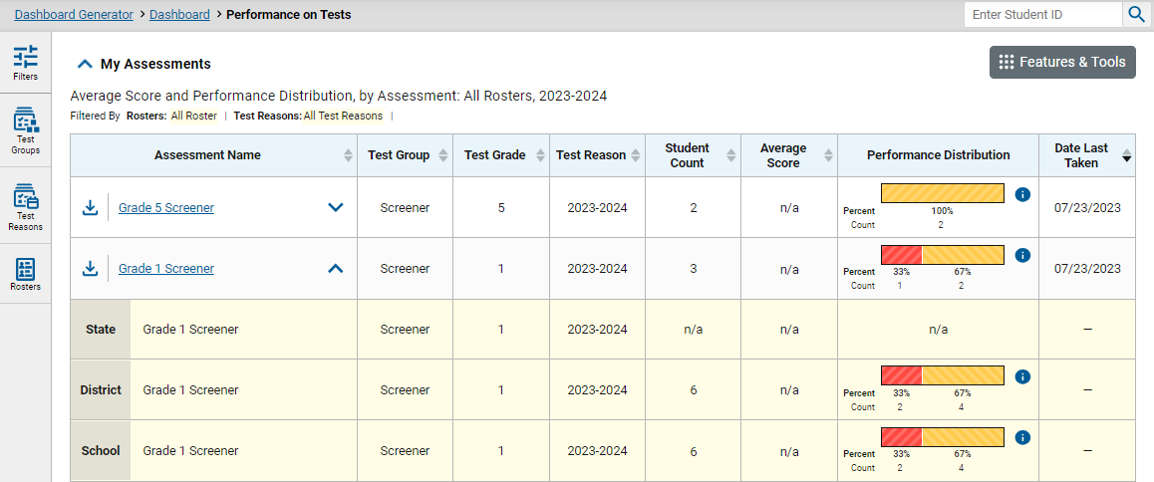
Compare Your Results to State, District, or School Level
Notes:
Typically, one of the first things a user is looking for is a comparison of their results to school-, district-, and state-level results. Navigate to the Performance on Tests page by clicking on a test group on the dashboard.
On the Performance on Tests page, click the expansion arrows to the right of the Assessment Name and aggregate scores will display below.

Slide 11
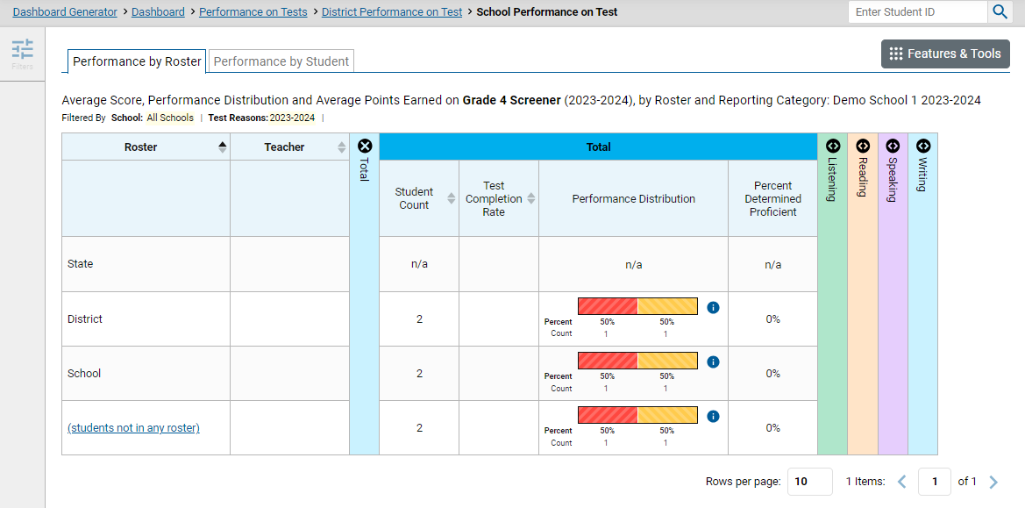
Navigate the Test Results Page
#2
#1
#3
Notes:
Clicking an assessment name will bring up test results pages. The page navigation trail is shown in a gray bar at the very top of every test results page. Here it reads Dashboard Generator > Dashboard > Performance on Tests > District Performance on Tests > School Performance on Test.
There are two tabs below the trail: The Performance by Roster and Performance by Student tabs. Users can toggle between the two depending on the data they wish to see.
Areas of interest on the page are as follows:
The state, district, and school results also display on the test results page for quick comparison to the roster results. A teacher will see a row of results for all of their students, as well.
Expanding the arrows in the column headings shows results in the four domain areas of the ELPA21 assessment: Listening, Reading, Speaking, and Writing. If you click on the information button next to the Performance Distribution bar, a Performance Levels legend appears, showing the performance level measurements.
Click on the name of the Roster to see a list of student results. Sorting will be available from the student test results page.

Slide 12
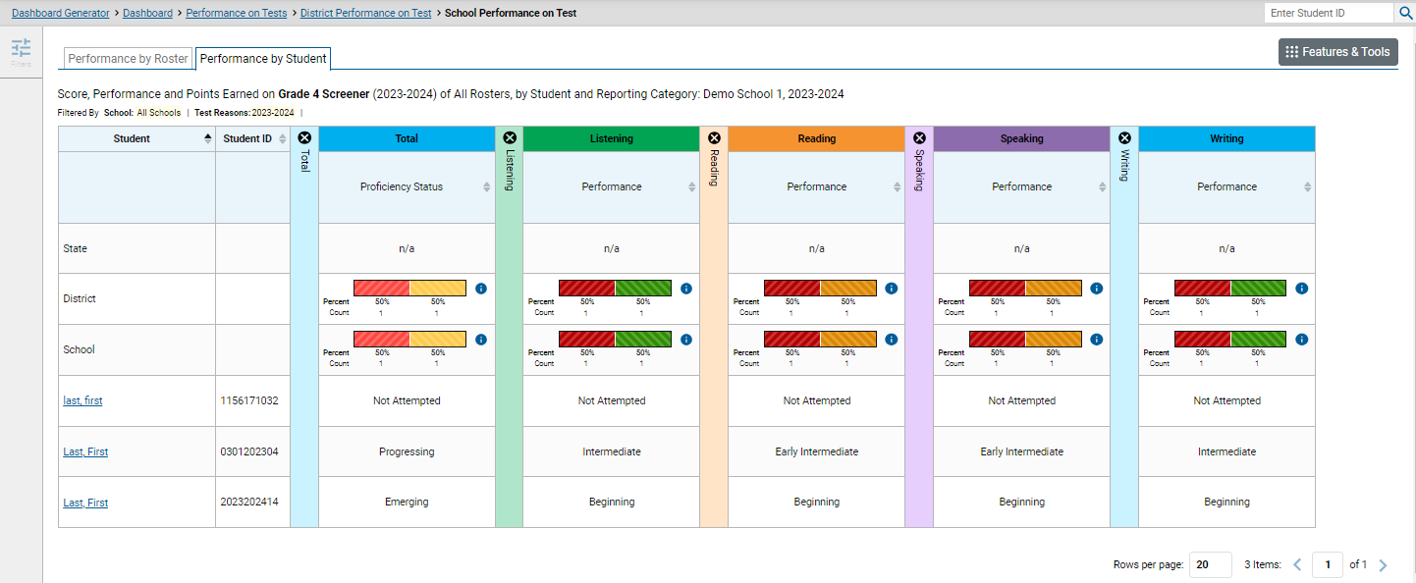
Performance Toggle Switch
Notes:
To see a list of all the students in the school, toggle to the Performance by Student tab. The results will automatically change to reflect the new selection. Sorting is possible in the Proficiency Status column, as well as the four domain columns.
On this screen, all assessment domains are selected and expanded.

Slide 13
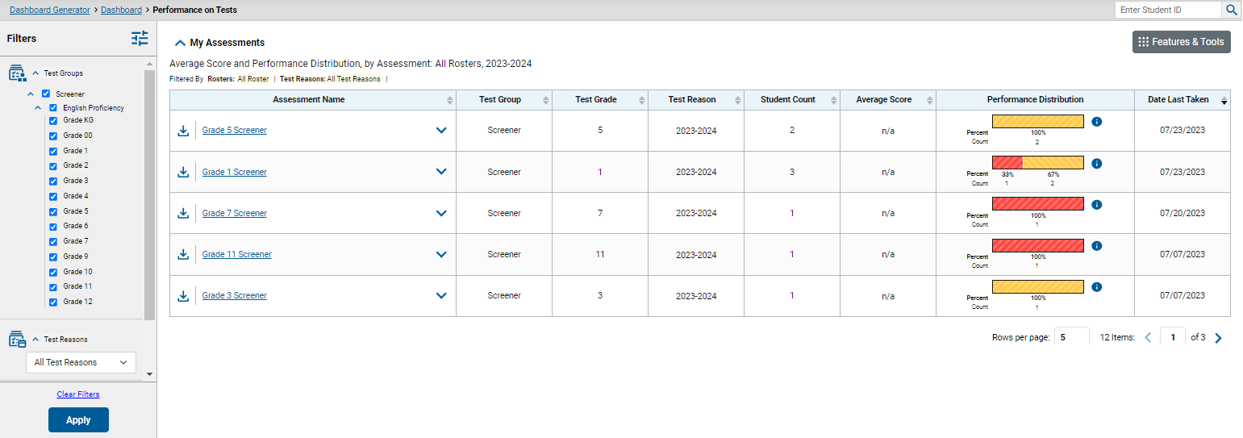
Setting Preferences with Filters
Notes:
To drill down to the most relevant results and eliminate unnecessary data, teachers and other users should take the time to set their preferences by using the filters in the Filters panel on the left. The options in the list of filters may vary, depending on user role.
Expand the filter panel by clicking the Filters button. Drop-down menus for Test Groups and Test Reasons are displayed. Test group selections are applied by checking the desired tests by test type and grade level. Test reason selections are made by highlighting a choice from the drop-down menu. The Apply button will set these filters and the dashboard table of contents will reflect them. Filter details will display in the table header. The filters remain in place until they are cleared by the user, or the user logs out of the Reporting System.

Slide 14
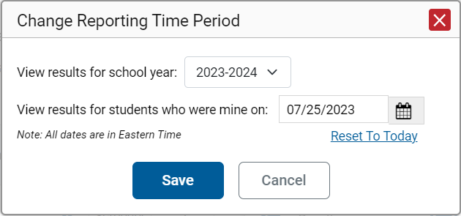
Change Reporting Time Period
Notes:
Changing the reporting time period allows users to view test results from a previous school year. When a reporting time period is set the reports show data for the completed test opportunities in the selected school year, and only for the students who were associated with the user as of the selected date.
If users don't change the reporting time period, or reset it to the default, all the reports in Reporting show test opportunities only for the current school year with current student data.
Here are some tips on changing the reporting time period:
To view current students' past performance, select the previous school year and keep the date set to today.
To view students at the end of an administration, select the school year of that administration, then set the date to the end of that administration or the last day of testing.
To view a student who is no longer associated with you, set the school year to a year in which they tested, then set the date to a day when the student was associated with you.

Slide 15
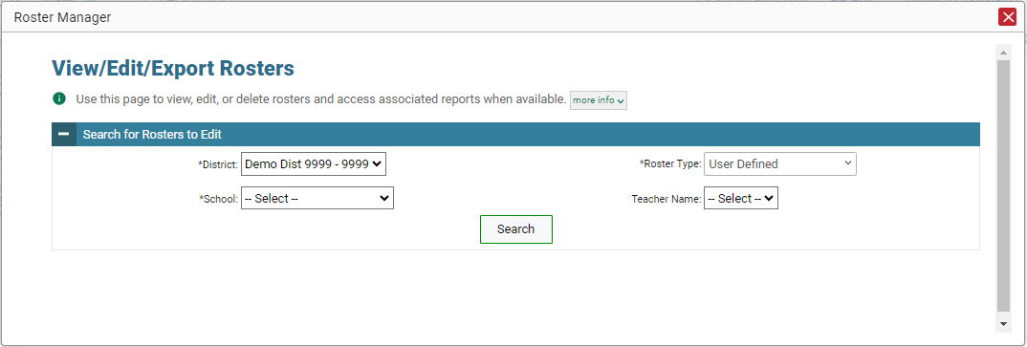
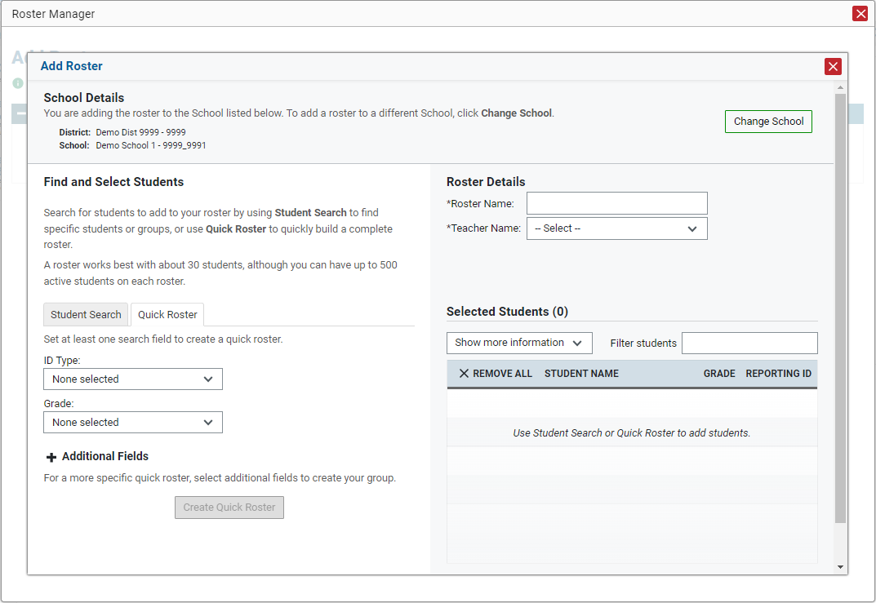
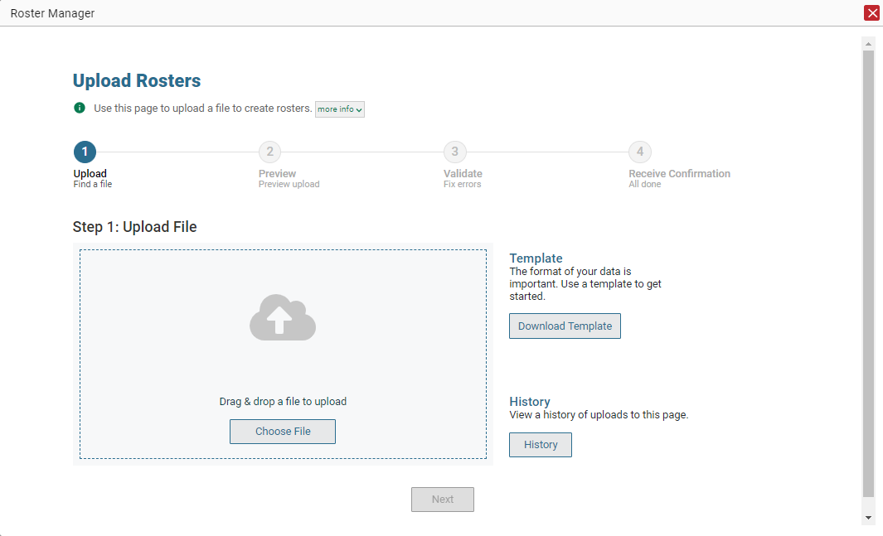
Roster Management For All Users
Notes:
Users, depending on their role, can add, edit, export, and upload rosters using the Roster Manager pop-up windows. This mirrors the roster management functionality in TIDE. District test coordinators and school test coordinators are able to build groups and assign students to them, allowing them to customize and update classroom rosters. Managing classes using these features is a great way to organize students, allow teachers to view their students’ performance, and generate information on incoming classes.
Refer to the Reporting System User Guide for specific instructions on using the Roster Manager windows.

Slide 16
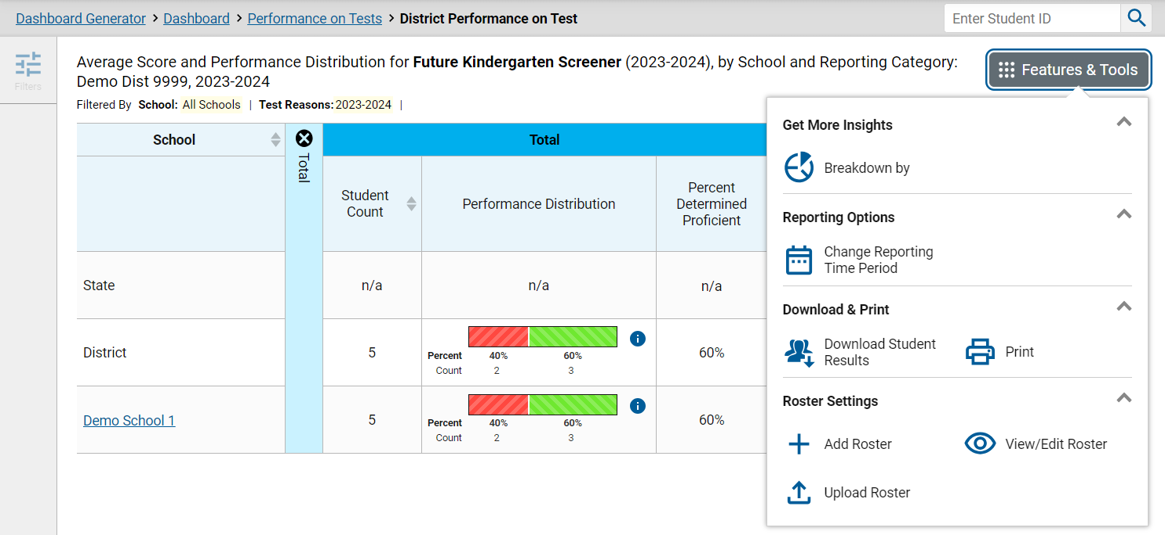
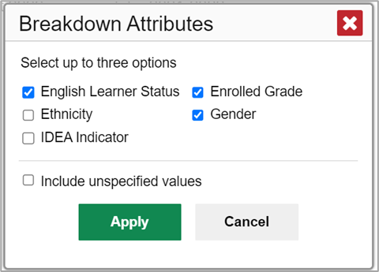
Setting Up the Demographic Sub-Group Report
Notes:
There is a useful setup tool that allows users to break down data by demographic sub-group. The Breakdown By button in the Features & Tools menu can be used to analyze performance between different demographic sub-groups. This tool is helpful in identifying groups that need more instructional support in the specific domains.
From any test results page (for multiple students) click the Breakdown by button. The Breakdown Attributes window opens. Select up to three student demographic categories from the choices.
Unspecified Values (optional): Some students who completed tests do not have specific demographic information in the Test Information Distribution Engine (TIDE). These students are considered to have unspecified values. To include the test data for these students in your results, mark the checkbox “Include unspecified values” and click Apply.

Slide 17
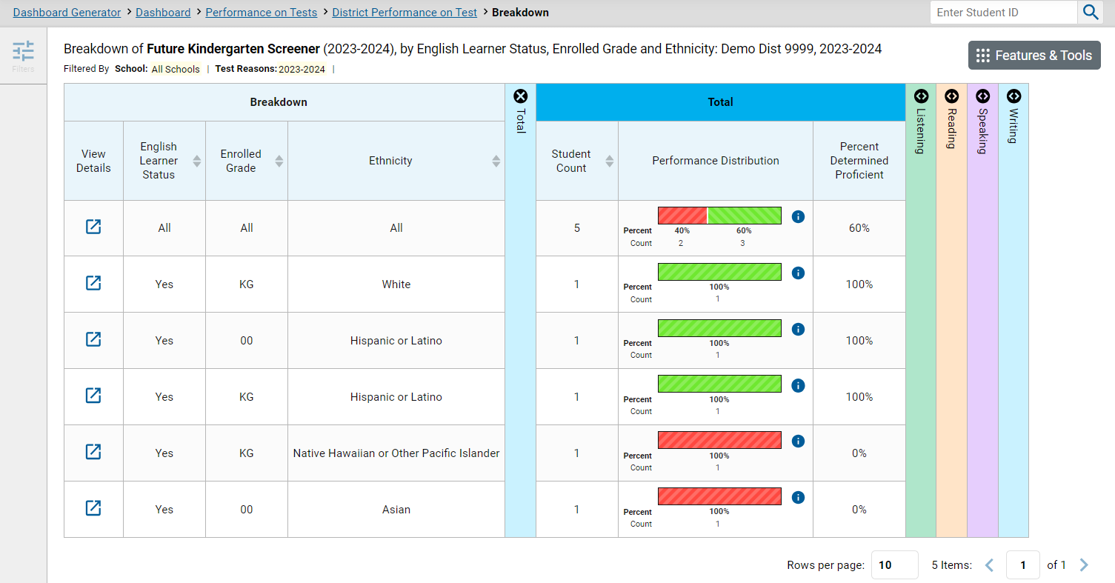
Breakdown of Demographic Sub-Groups
Notes:
Demographic columns appear on the test results page, one for each category chosen from the Breakdown Attributes menu. To the left of each column is a View Details button for that row of information. A row appears for each possible combination of demographic groups in the selected categories. If there are no students in a particular combination, no row appears for that combination. Some sorting can be done with the category columns.

Slide 18
Breakdown of Demographic Sub-Groups (Continued)
Notes:
Test results for each demographic sub-group can be seen by clicking the View Details button to the left of each row. A window will open, displaying detailed results for that combination. This report table is now laid out the same way as the original report. At the top of the pop-up report table are filter menus for each demographic category chosen by the user. Combinations may be changed by using the filter arrows and clicking Apply. The new combination will be displayed.
Users can get an in-depth look at specific groups of students and their performance on specific domains. It’s helpful to sort by domain performance.

Slide 19
The Student Portfolio
The Student Portfolio can be used to complete a number of tasks:
See all the tests taken, over time, by a student.
Compare a student’s results with state, district, and school levels.
Filter a student’s results to show performance on tests taken in previous years.
Sort a student’s results to see performance on recent tests.
Generate and print an Individual Student Report (ISR).
Generate and print a Student Data File.
Notes:
The Student Portfolio page is a powerful tool for all users. State, district, and school personnel can navigate to the report by entering a student identification number in the search box, located in the upper right margin of any page.
The Student Portfolio page can be used to complete a number of tasks tasks:
See all tests taken, over time, by a student.
Compare a student’s results with results for your state, district, school, and/or all students.
Filter a student’s results to show performance on tests taken in previous years.
Sort a student’s results to see performance on recent tests.
Generate and print an Individual Student Report (ISR).
Generate and print a Student Data File.

Slide 20
Student Portfolio—Analysis By Sorting/Comparing
Notes:
All the assessments taken by the student in the current school year are listed in the Assessments Table.
Comparison rows of State, District, and School aggregate results are shown when the expansion arrow is clicked. You can see that the filter panel now includes an option for school year selections.

Slide 21
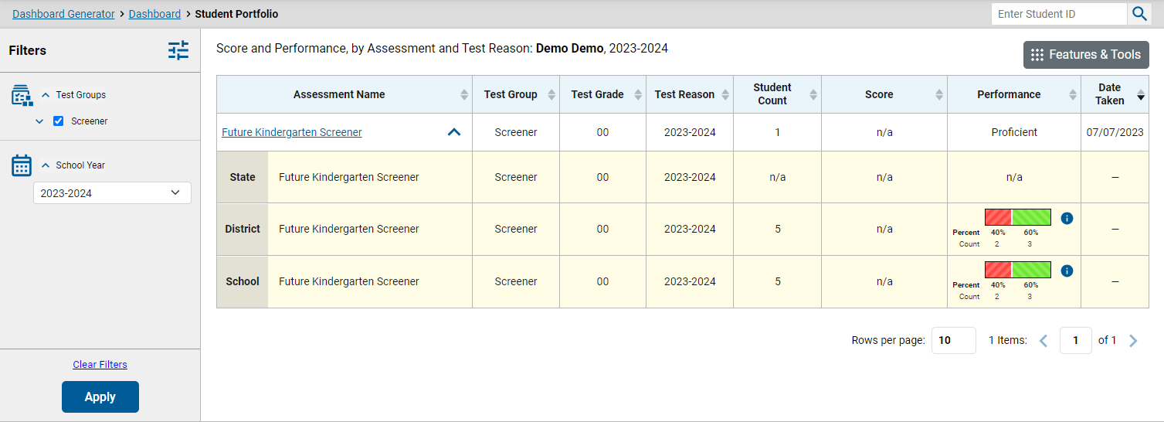
Filter Assessments by School Year
Notes:
To view a student’s test performance from previous school years, click the School Year option from the expanded Filters menu. Select desired years and click Apply.
The assessments from the selected school years are now displayed in the table. Sorting may be done by Test Reason, Score, and Date Taken. State-, district-, and school-level results may be expanded beneath the name of the assessment.
To clear filters, click Clear Filters and then Apply.

Slide 22
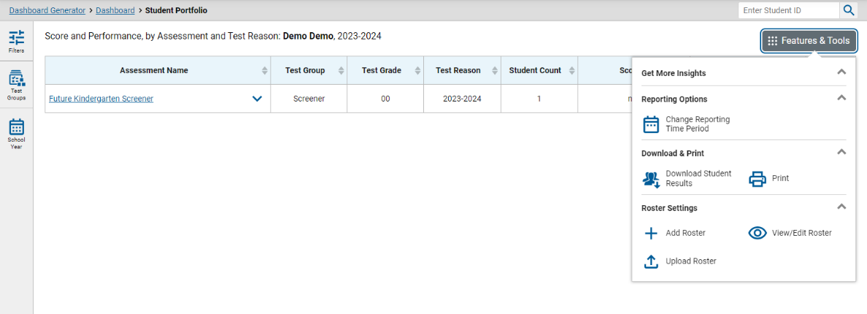
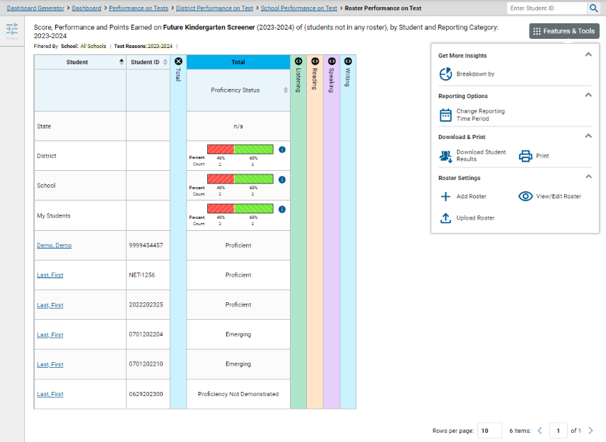
Generate Individual and Multiple Individual Student Reports (ISRs)
Notes:
An Individual Student Report (ISR) shows a student’s overall performance on a test plus a breakdown of performance by domain. ISRs can be printed individually or in batches for multiple students. The Student Results Generator is used to generate ISRs. It can be accessed from almost any page of test results.
Click the Features & Tools menu button and then the Download Student Results button in the upper-right corner of the page to display the Student Results Generator window. When you click the wizard from a page of test results the options available to you may be pre-populated or pre-selected. You may change the selections whenever necessary.

Slide 23
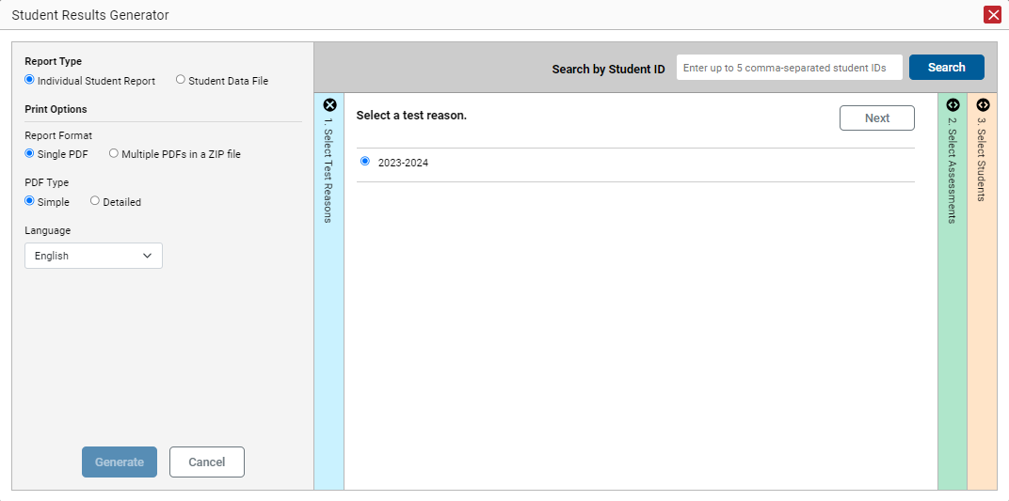
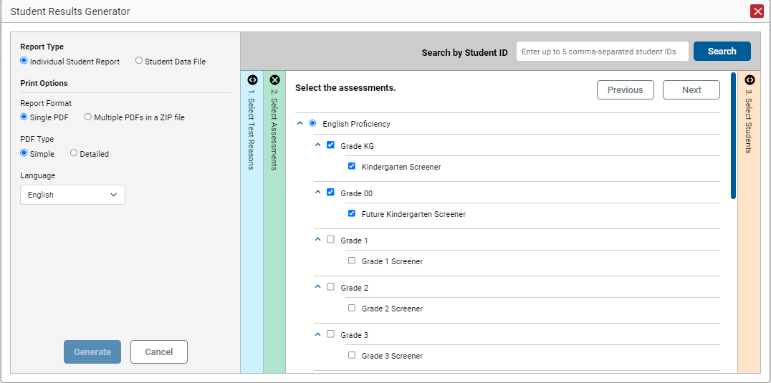
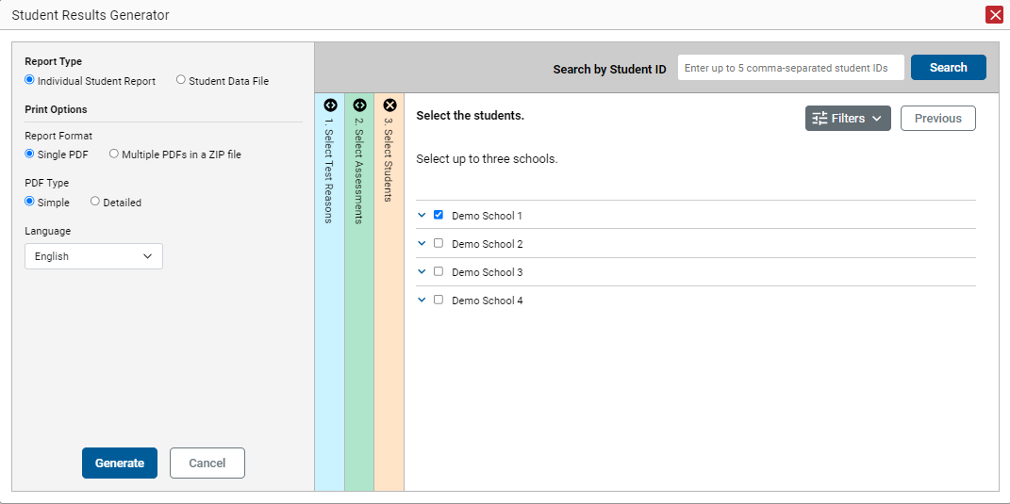
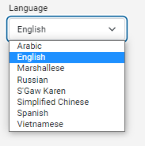
Generate Multiple ISRs
Notes:
In the Student Results Generator window:
Click the ISR radio button under Report Type.
Choose the Report Format and the PDF type. Use the Single PDF radio button for a single ISR. Use the Multiple PDFs in a ZIP file to print a batch of reports for multiple students.
Starting at the left margin, click the section bars to expand the colored sections. Within each section, you must make certain selections: Select Test Reasons, Select Assessments, and Select Students.
Choose a print language for the ISR from the Language radio button. Available languages will vary according to state settings.
Click the Generate button, and the new ISR(s) will be stored in the Secure File Center, available for downloading and printing.

Slide 24
Reporting Secure File Center
Notes:
The Secure File Center stores any PDF versions of reports you generate from the Student Results Generator. These files automatically expire after a designated period. Users can access the Secure File Center from the Reporting banner.
The Recent tab displays all files except those that have been archived. The Archived tab displays files that have been archived.
Other options in the Secure File Center include a toggle switch for showing or hiding system labels and custom labels, a search box to help with filtering the results listed in the Secure File Center, and the archive and delete buttons.
You can create a new custom label by clicking the label icon.
To download a file, click the name of the file.

Slide 25
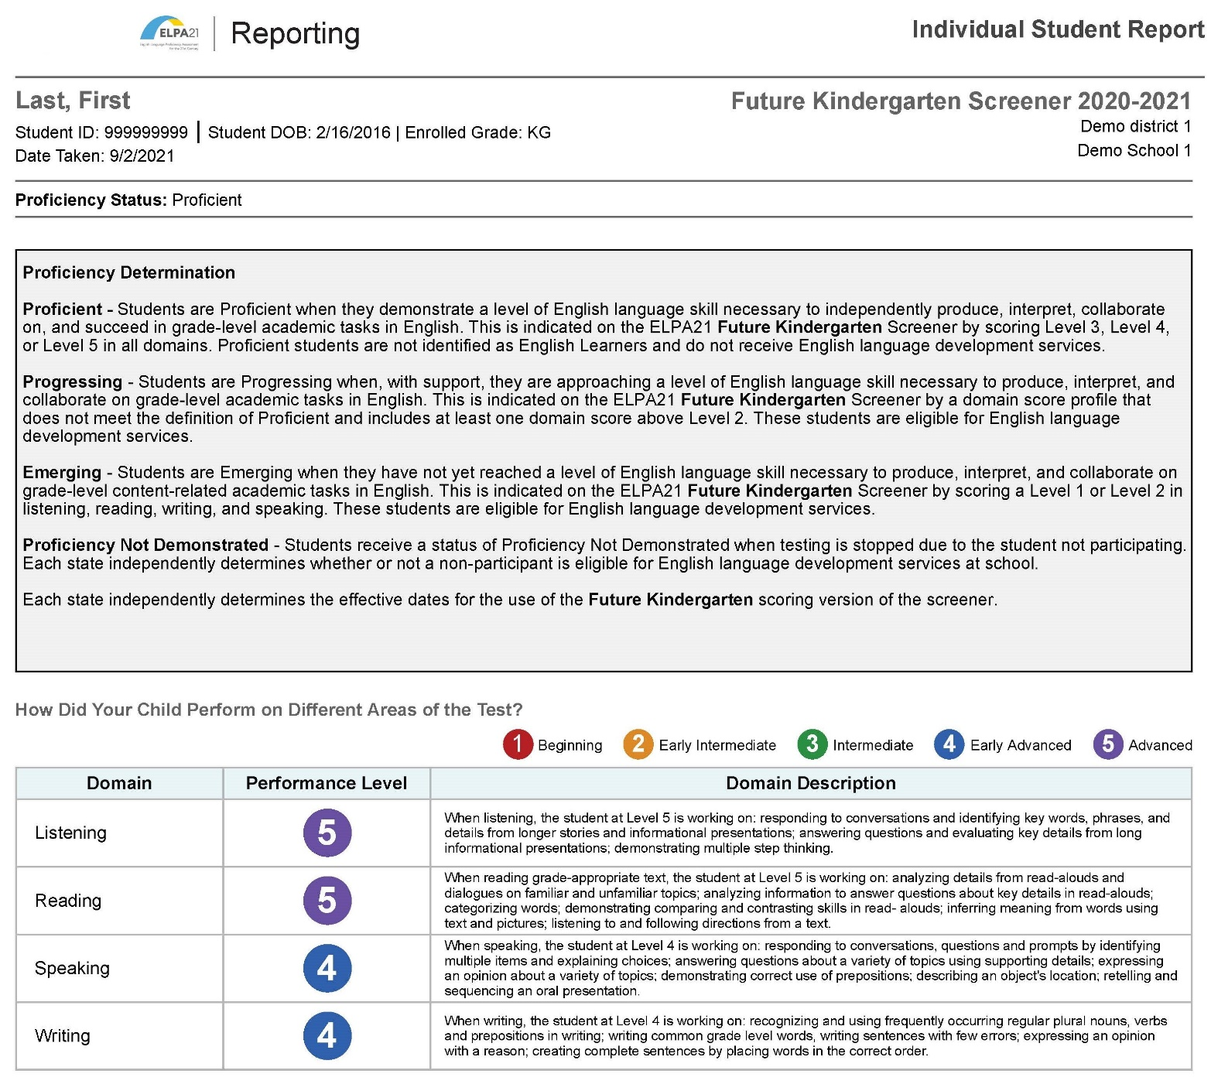
Sample ISR Screener
Sample Screener ISR Future Kindergarten
Notes:
Test results are reported in several different ways for this Future Kindergarten Screener assessment. The Proficiency Status is displayed above the Proficiency Determination box that shows the performance level descriptors for the four levels: Proficient, Progressing, Emerging, and Proficiency Not Determined.
Below the Proficiency Determination box is a table of Domain Performance that reflects the student’s performance in each of the four domains of the test. Each domain performance category is reported as beginning, early intermediate, intermediate, early advanced, or advanced.

Slide 26
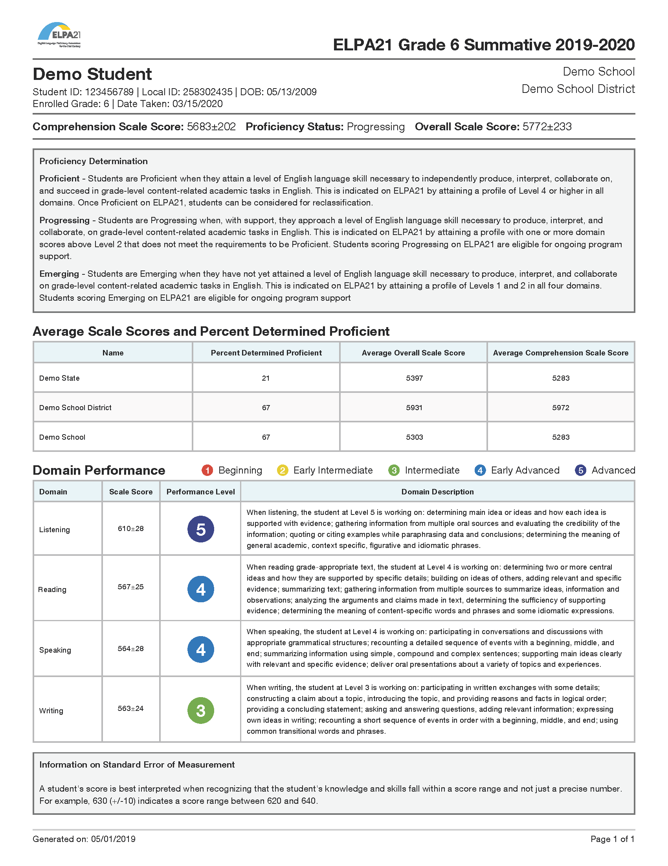
Sample ISR Summative
Sample Summative ISR Grade 6
Notes:
Individual student test results for the ELPA21 Summative are reported in three major ways, as well. A summary of performance is listed as Comprehensive Scale Score, Proficiency Status, and Overall Scale Score. Proficiency Determination levels are described as Emerging, Progressing, and Proficient in the Proficiency Determination box. Average scale scores are compared with the state, district and school results in the comparison table in the middle of the report. A student’s performance within the four domains are explained in the Domain Performance table.

Slide 27
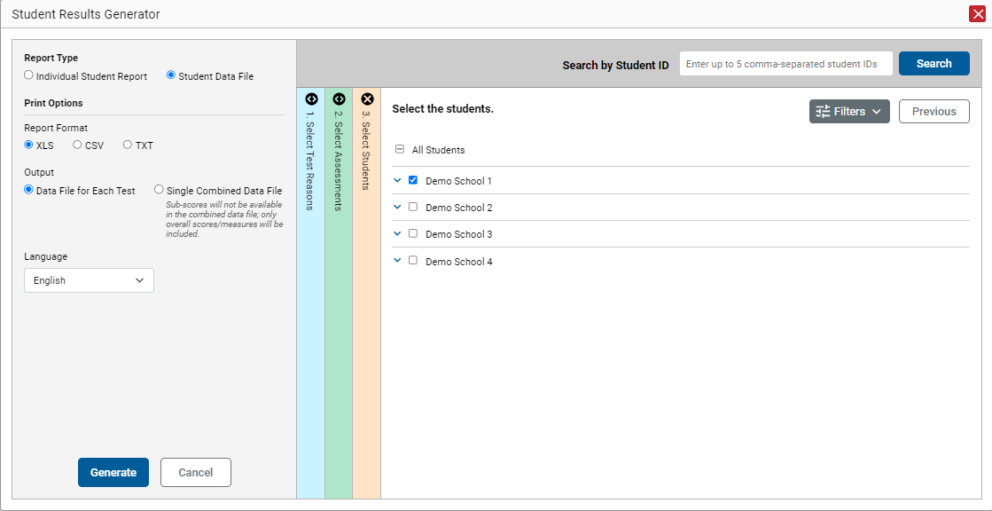
The Student Data File
Notes:
Teachers and other users can choose to generate and print the Student Data File. This file includes the SAME information that the ISR details, but the report format is either a Microsoft Excel workbook file, a CSV file, or a text file. Printing reports in these formats will allow the user to use the features of Excel and word processing software to organize the data with a high degree of utility.
The setup instructions for a Student Data File are the same as for an ISR, except for the selections on the Report Type and Print Options panel on the left side of the Student Results Generator page.

Slide 28
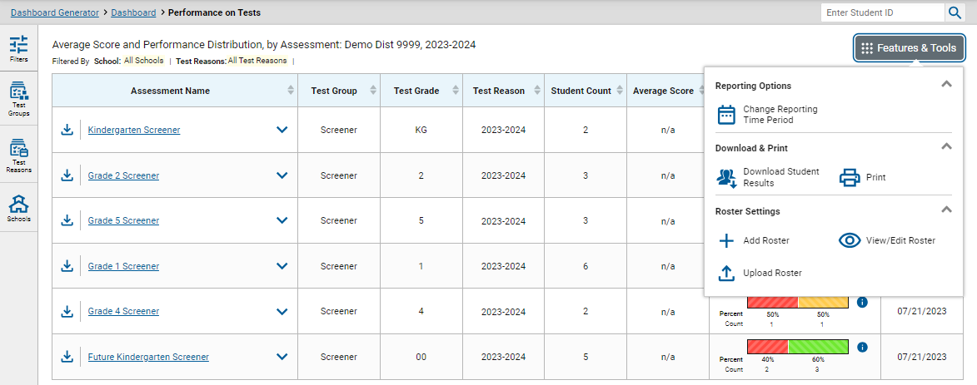
Print or Export Data You Can View
#2
#1
Notes:
Users can print or export any data from Reporting.
Use the Print button in the Features & Tools menu to create a quick hard copy of any report or results displayed on the results page.
The export button (to the left of each assessment on the dashboard) generates a detailed report of any specific test. Users may choose from a PDF file (a picture) or a CSV file (an Excel spreadsheet). The file will generate in the user’s Secure File Center and can be downloaded from there for up to 29 days.
Different options are available depending on the report being viewed.

Slide 29
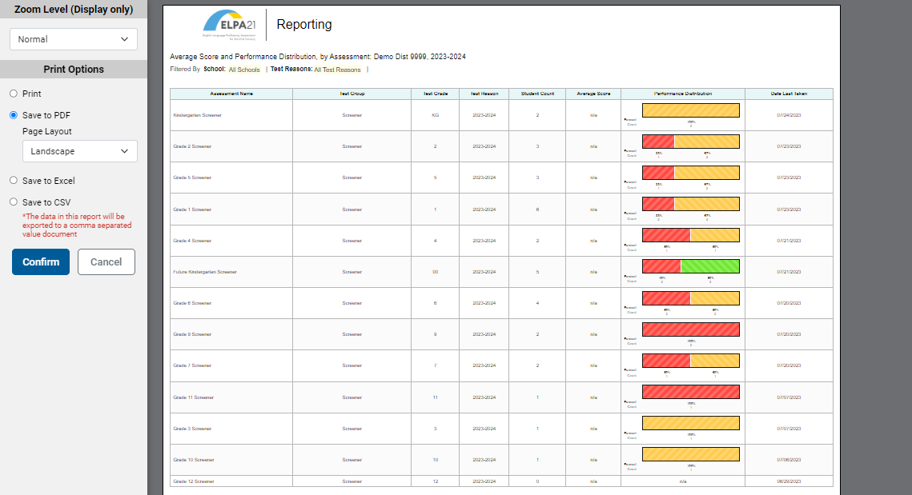
1. Print Any Page You Can See
Notes:
For a quick copy of any page of results you are viewing, click the Print button and check the Save to PDF radio button. Click Confirm and a copy of the report will save in your Secure File Center.

Slide 30
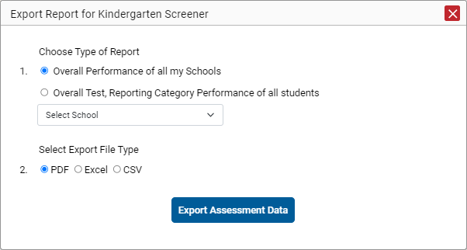
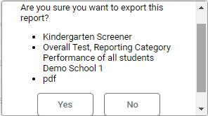
2. Export Data to the Secure File Center
Notes:
This slide shows the export choices for a state user who has clicked the Export Assessment Data button from the dashboard page. The user must choose a type of report and a file type. Clicking the Export Assessment Data button brings up a confirmation page that shows the name of the assessment, the type of report chosen, and the type of file chosen. Click Yes. The user’s Secure File Center will immediately open and display the report.

Slide 31
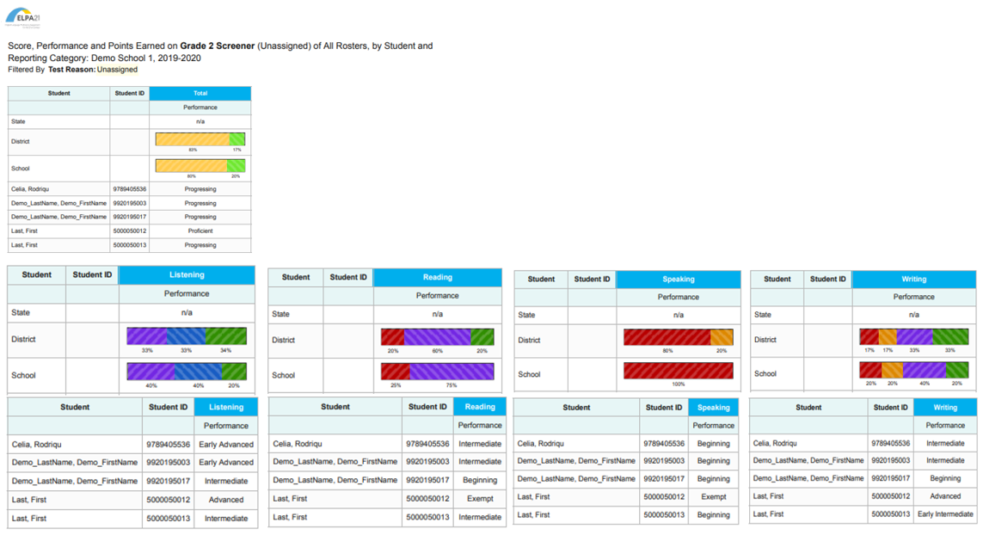
Schoolwide Report for Grade 2 Screener, by Domain
Notes:
The report shown here is a schoolwide report of the results of the Grade 2 Screener for Demo School 1. It shows the total performance levels for the district, the school, and the students in the first table. The next 8 tables show the results for the four domains by comparison aggregates and by individual student at the school.

Slide 32
Thank You!
For more information, consult the following resources available on your state portal:
Reporting System User Guide
Reporting System Quick Guide
Users can also contact their state Help Desk if they have any other questions.
Notes:
Thank you for taking the time to view this training module. For more detailed information, consult the additional Reporting System resources located on your state portal.

