Slide 1
Participation Reports
Training Module
Copyright © 2023 Cambium Assessment, Inc. All rights reserved.
Notes:
This training module will introduce you to participation reports in the Test Information Distribution Engine, also known as TIDE. Participation reports help schools and districts monitor testing progress during the test administration window.
All participation reports are located within TIDE. For an overview and detailed instructions for accessing TIDE, please view the TIDE training modules.

Slide 2
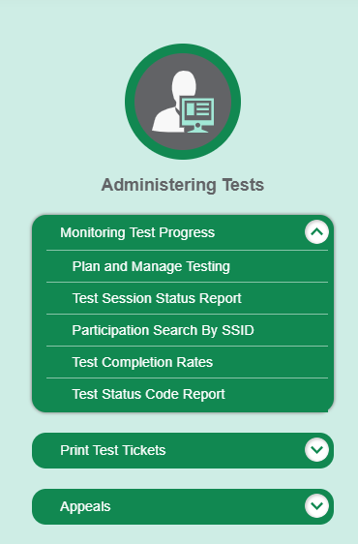
Monitoring Test Progress
Notes:
The tasks available in TIDE’s Monitoring Test Progress task menu allow you to generate various reports that provide information about a test administration's progress.
Several types of participation reports are available:
The Plan and Manage Testing Report details all of a student’s test opportunities and the status of those opportunities.
The Test Session Status Report allows district and school coordinators to view status reports of active and inactive test sessions happening in their district or school.
The Participation Search by SSID allows a user to generate a report for an entered list of students or the ability to upload a roster.
The Test Completion Rates Report summarizes the number and percentage of students who have started or completed a test.
The Test Status Code Report displays a student’s information, test name, current test status, and the special code assigned, if applicable. This section is not applicable for the Screener.

Slide 3
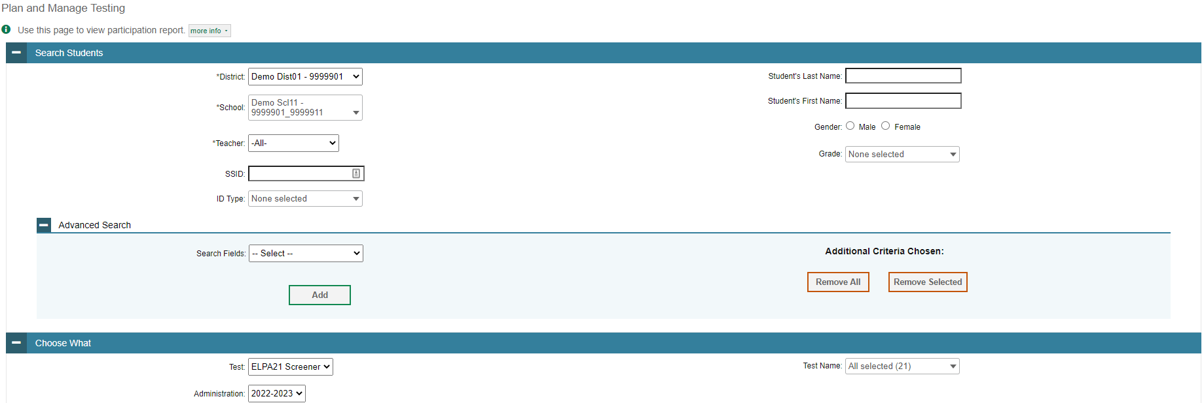
Plan and Manage Testing, Steps 1-2
Notes:
Plan and Manage Testing reports detail each student’s test opportunity and its status.
To generate a report from the Plan and Manage Testing page, use the Search Students panel to select the parameters for whose information to include in your report. Optionally, you may also choose a teacher from the Teacher drop-down list. You may also search by SSID, student name, gender, and grade.
The Advanced Search fields include “Paper Tester,” Section 504, ethnicity, and others.
Next, use the Choose What panel to select a test category and administration. Optionally, you may also choose a test name.

Slide 4
Plan and Manage Testing, Step 3
Notes:
Finally, set the desired options in the Get Specific panel. There are five separate options to choose from. They are:
The ability to filter students who have or have not started or completed their 1st or any test opportunity.
The ability to filter students by current test opportunity and expiration date or within a date range.
The ability to filter students who have completed their first or any opportunity by a range of statuses including paused, pending, suspended, and others.
The ability to filter by Session ID number and TA name within a range of dates.
The option to search by SSID or name of student.
You can use participation reports to determine if a student’s test has been submitted prematurely, for example, a paused test that was auto-submitted before the student could complete it. In such cases, an appeal will need to be created in TIDE for that test to be reopened. For information about creating appeals, see the TIDE User Guide or the Appeals Process training module.
Click Generate Report to view your Plan and Manage Testing report or click Export Report to open the report in Excel.

Slide 5
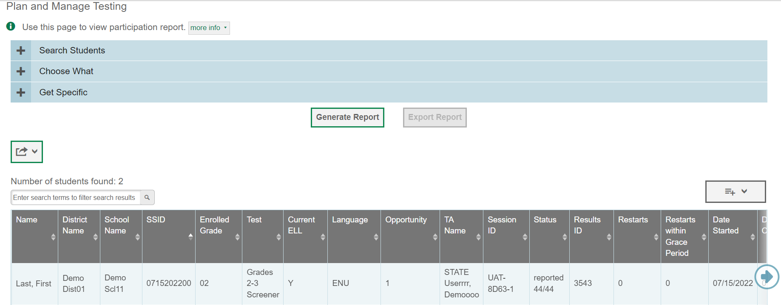
Plan and Manage Testing Results
Notes:
Clicking Generate Report will display the report and collapse the Report Criteria panel. Because not all columns can fit on the screen at once, you may need to click the blue arrow on the right side of the screen to scroll right and display more information.

Slide 6
Plan and Manage Testing Scenarios
Which students have not yet tested?
Which students have tests that will expire tomorrow?
Which students have paused tests?
Did all the students in a test session submit their tests?
Has a particular student taken the test yet?
Notes:
This slide illustrates some common questions that can be answered using the options available in the Step 3: Get Specific panel.
Button #1: To find students who have not yet tested, select the first radio button and search for students who have not completed their first opportunity in the selected administration.
Button #2: To find students whose tests will expire tomorrow unless they are submitted, select the second radio button and search for students whose current opportunity will expire in 1 day.
Button #3: To find students who have paused tests, select the third radio button and search for students on their first opportunity in the selected administration with a status of paused.
Button #4: To find out if all students in a test session submitted their tests, select the fourth radio button and search for students by test session ID between the dates when the test session took place.
Button #5: Finally, to find out if a particular student has taken the test, select the last radio button and enter their student ID number.

Slide 7
Test Session Status Report
Notes:
The Test Session Status Report allows district and school coordinators to view status reports of active and inactive test sessions happening in their district or school.
These reports show how many students in each school are testing and how many have started, paused, and completed their test.
To generate this report, select your district and school and click Generate Report.

Slide 8
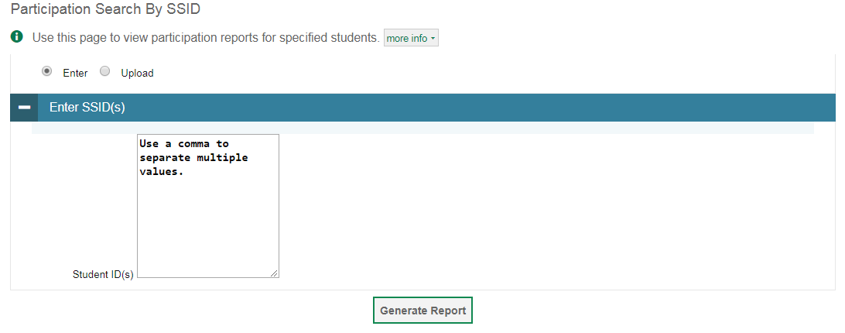
Participation Search by SSID
Notes:
The Participation Search by SSID page allows you to generate participation reports for specified students. Enter a single SSID or multiple SSIDs separated by commas in the Student ID(s) box. You can also upload a Participation Search by SSID single-row Excel file containing student ID numbers. Click Generate Report to view the results.

Slide 9
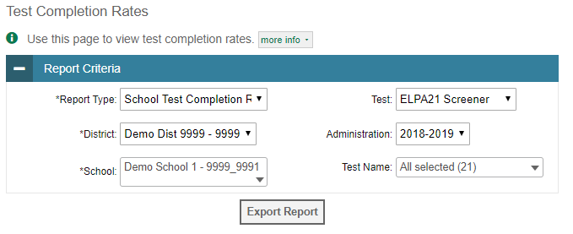
Test Completion Rates
Notes:
The Test Completion Rates report summarizes the number and percentage of students who have started or completed a test.
To generate a report from the Test Completion Rates page, choose whether to generate a State, District, or School report from the Report Type drop-down list. Select a district, school, and test name from the corresponding drop-down lists, if available. If desired, select an administration from the drop-down list.
Click Export Report to open the report in Excel.
Test Completion Rate reports are updated only once each day, in the early morning hours. They will not reflect students who tested on the day you run the report.

Slide 10
Thank You!
For additional information, consult your state portal page, which contains:
Important announcements
TIDE User Guide
For further assistance, please consult your state’s Help Desk.
Notes:
Thank you for viewing this training module. If you need additional information, please visit your state portal, where you can find announcements and copies of the TIDE User Guide. For further assistance, please consult your state’s Help Desk.

